Slide 1
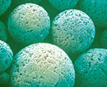
Size Exclusion Chromatography: NGSS 3Dimensional approach
Bio-Rad Biotechnology Explorer™ 1660008EDU

Slide 2
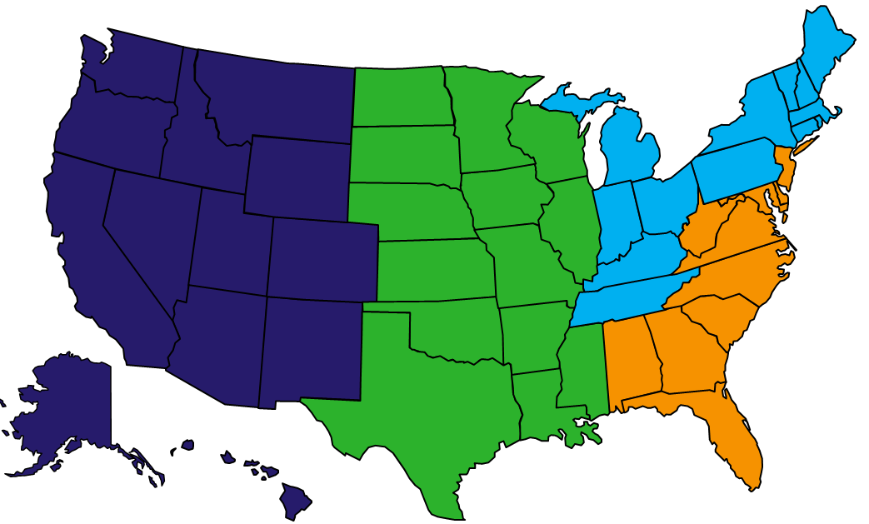




Instructors - Bio-Rad Curriculum and Training Specialists
Damon Tighe
damon_tighe@bio-rad.com
Tamica Stubbs
Tamica_stubbs@bio-rad.com
Sherri Andrews, Ph.D.
sherri_andrews@bio-rad.com
Leigh Brown
leigh_brown@bio-rad.com

Slide 3
Bio-Rad Resources
@BioRadEducation
Biotechnology: A Lab Skills Course
Pinterest.com/teachbiology
bit.ly/b-rdropbox

Slide 4
Major NGSS Alignments
HS-LS1-1 | Construct an explanation based on evidence for how the structure of DNA determines the structure of proteins which carry out the essential functions of life through systems of specialized cells. [Assessment Boundary: Assessment does not include identification of specific cell or tissue types, whole body systems, specific protein structures and functions, or the biochemistry of protein synthesis.]
HS-PS1-3 | Plan and conduct an investigation to gather evidence to compare the structure of substances at the bulk scale to infer the strength of electrical forces between particles. [Clarification Statement: Emphasis is on understanding the strengths of forces between particles, not on naming specific intermolecular forces (such as dipole-dipole). Examples of particles could include ions, atoms, molecules, and networked materials (such as graphite). Examples of bulk properties of substances could include the melting point and boiling point, vapor pressure, and surface tension.] [Assessment Boundary: Assessment does not include Raoult’s law calculations of vapor pressure.]

Slide 5
Work Flow
Observe a phenomenon
  Model what you think is going on
Read about a phenomenon & discuss
  Revise your model
Design and execute an experiment testing your model
  Analyze results, argue from evidence
  Revise your model

Slide 6
Phenomenon videos
https://www.youtube.com/watch?v=EZ5Wql5Kamw
https://www.youtube.com/watch?v=3lcAveGioaE
If you can’t access youtube at school add “ss” before youtube on any video at home and you can download the video
Notes:
What you tell the audience – There are columns packed with some sort of material and researchers are placing a mixture of different colored molecules up top and flowing a buffer down the column.

Slide 7
Modeling 1
In your notebook (5 minutes)
  Write 1-2 sentences of why these different colored molecules are separating in the columns
  Draw a cartoon that helps explain your reasoning with captions
    Draw at two different scales
      Human scale
      Molecular scale

Slide 8
Modeling 2
Share your model with your neighbor (2 minutes)
Revise your model (2 minutes)

Slide 9
Reading
With a neighbor whisper read the Gel Filtration Chromatography text (5 minutes)
  Each of you should read half to the other
    Help each other decipher words
Notes:
http://www.bio-rad.com/featured/en/gel-filtration-chromatography.html

Slide 10
Close Reading
Read silently, underlying key ideas and terms (5 min)
Keep in mind the question:
  “How does Size Exclusion Chromatography Separate Molecules?”
Revise your cartoon model with what you’ve learned (2 min)

Slide 11
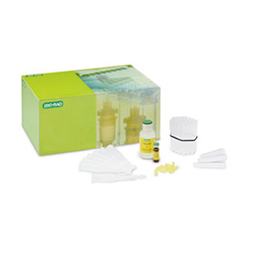
Use an experiment to test models
The materials we have for us to test our models
  Vitamin B12
  Hemoglobin
  Columns
  Solid phase – polyacrylamide P60 beads
  Mobile phase – column buffer

Slide 12
Close Reading
Read the text on the two molecules we are going to attempt to separate and the text on the solid phase to be used in Size Exclusion Chromatography (5 min)
  Highlight/underline information that you think will be important to understanding how the molecules will separate

Slide 13
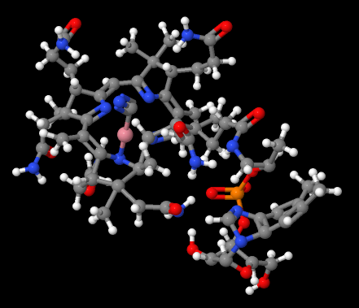
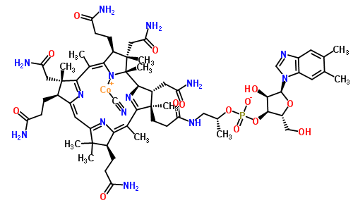
Vitamin B12 (Cyanocobalamin)
1,350 Daltons
CSID:24921423, http://www.chemspider.com/Chemical-Structure.24921423.html (accessed 19:55, Sep 8, 2015)

Slide 14
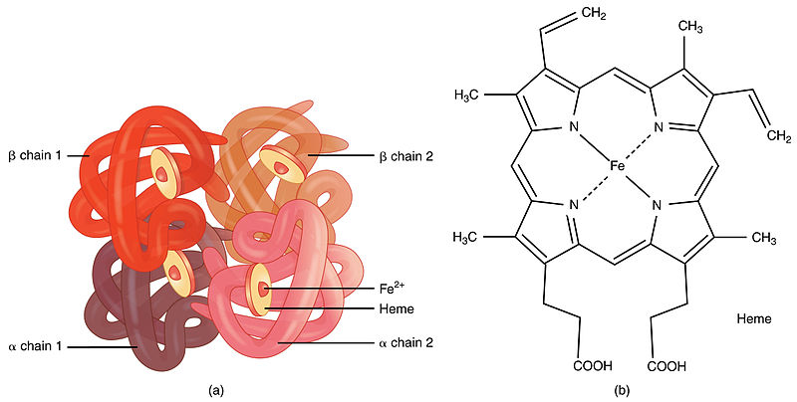
Hemoglobin
65,000 Daltons
https://commons.wikimedia.org/wiki/File:1904_Hemoglobin.jpg

Slide 15

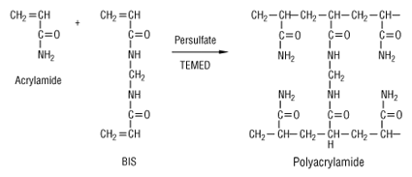
Size Exclusion Matrix – Polyacrylamide
60
kD
Notes:
SEC beads are polyacrylamide P60’s meaning they exclude sizes above 60,000 Daltons

Slide 16
Compare the sizes with a quick model
How much larger is Hemoglobin then Vitamin B12?
  We are going to use the assumption that mass (Daltons) closely reflects size (Angstroms)
  Turn on your basic math skills!
Make a quick cartoon of the size difference
Notes:
Kahoot!

Slide 17
Visual Model of Molecule Sizes (scale)
Vitamin B12
1,350 Daltons
~48X Greater in Size
Hemoglobin
65,000 Daltons

Slide 18


Making Predictions based upon models
Which molecule will exit the column first?
  Hemoglobin?
  Vitamin B12?
Quick formative assessment tool
On your device type in :

Slide 19
Carry Out Experiment
1. Label 10 collection tubes sequentially
2. Label last 2 tubes “waste” and “column buffer”
3.Aliquot 4ml of Column buffer into the tube labeled column buffer

Slide 20
Carry Out Experiment
4. Remove the cap and snap off the end of the sizing column
5. Allow all of the buffer to drain into the waste tube
6. Cap the end of the column

Slide 21
Carry Out Experiment
7. Place column in tube 1
8. Add 1 drop of protein mix

Slide 22
Carry Out Experiment
9. Carefully add 250ul of column buffer to the top of the column (2x) and begin to collect drops into tube 1 - Size separation will work best when the column is left undisturbed
10. Carefully add 3ml of column buffer to the column
11. Transfer column to tube 2 and begin fraction collection
12. Collect 5 drops of buffer into tube 2 and transfer the column to tube 3
14. Repeat the same collection procedure collecting 5 drops into each tube
15. Collect 10 drops at tube 10

Slide 23
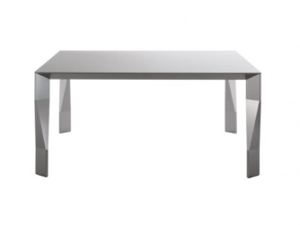


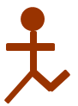
Additional Modeling Ideas
Kinesthetic Size Exclusion Chromatography model
  Everyone line up against one wall of the room
  Count off as Hemoglobin and Vitamin B12
  On the count of 3, everyone try to migrate to the opposite side of the room
    Vitamin B12s must stop and sit briefly in any chair they encounter along the way

Slide 24
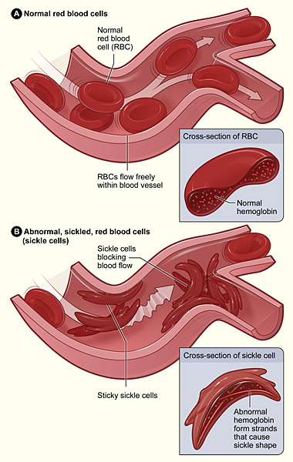
Sickle Cell Anemia and Hemoglobin
Normal Cell Sickle Cell
DNA: CCT GAG GAG CCT GTG GAG
Protein: Glu Val
www.nhlbi.nih.gov
Notes:
In the reading there was already some primers laid that said sickle cell caused rod shaped hemoglobin.
Doe Kinesthetic model again with sickle cell
Argue about how this would look and what you could do to better resolve

Slide 25
Data Collection
Record your observations and document your results
  Draw and label what you see in your tubes
Did the outcome match your prediction?
Produce a Claim, Evidence and Reasoning statement using your results.
  Use molecule size
  Solid phase pore size

Slide 26
Data Collection
Share your Claim, Evidence and Reasoning with a neighbor.
  Listen for Claim, the use of Data as Evidence and the reasoning of how that supports the claim

Slide 27
Visual Model of Molecules and Bead Pores
Vitamin B12
1,350 Daltons
not to scale
Hemoglobin
65,000 Daltons
Bead pores 60,000 Daltons

Slide 28
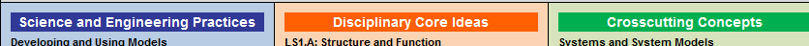
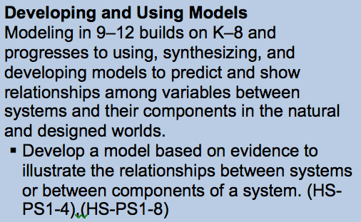
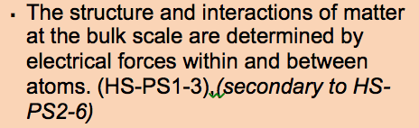
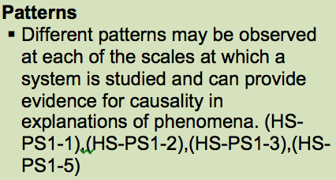
NGSS PEs
HS-PS1-3 | Plan and conduct an investigation to gather evidence to compare the structure of substances at the bulk scale to infer the strength of electrical forces between particles. [Clarification Statement: Emphasis is on understanding the strengths of forces between particles, not on naming specific intermolecular forces (such as dipole-dipole). Examples of particles could include ions, atoms, molecules, and networked materials (such as graphite). Examples of bulk properties of substances could include the melting point and boiling point, vapor pressure, and surface tension.] [Assessment Boundary: Assessment does not include Raoult’s law calculations of vapor pressure.]

Slide 29
Sickle Cell Anemia
Using your model, predict how sickle cell hemoglobin would behave in Size Exclusion Column Chromatography.
  Would it move slower or faster then normal hemoglobin?
  Design an experiment
    What outcomes would support your model’s prediction
    What outcomes would contradict your model’s prediction?

Slide 30
NGSS
HS-LS1-1 | Construct an explanation based on evidence for how the structure of DNA determines the structure of proteins which carry out the essential functions of life through systems of specialized cells. [Assessment Boundary: Assessment does not include identification of specific cell or tissue types, whole body systems, specific protein structures and functions, or the biochemistry of protein synthesis.]

Slide 31
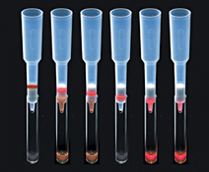
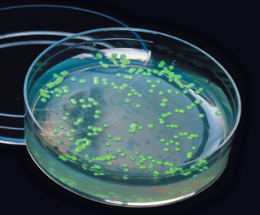
Extension Ideas
GFP is 26,900 Daltons which is betweenVitamin B12 and Hemoglobin so you could take pGLO lysate and add it to the column and have student make predictions about where it should run!
+

Slide 32
Size Exclusion Chromatography 1660008EDU
Notes:
Are there other things that would allow you to use this kit to hit even more NGSS standards?

