Slide 1
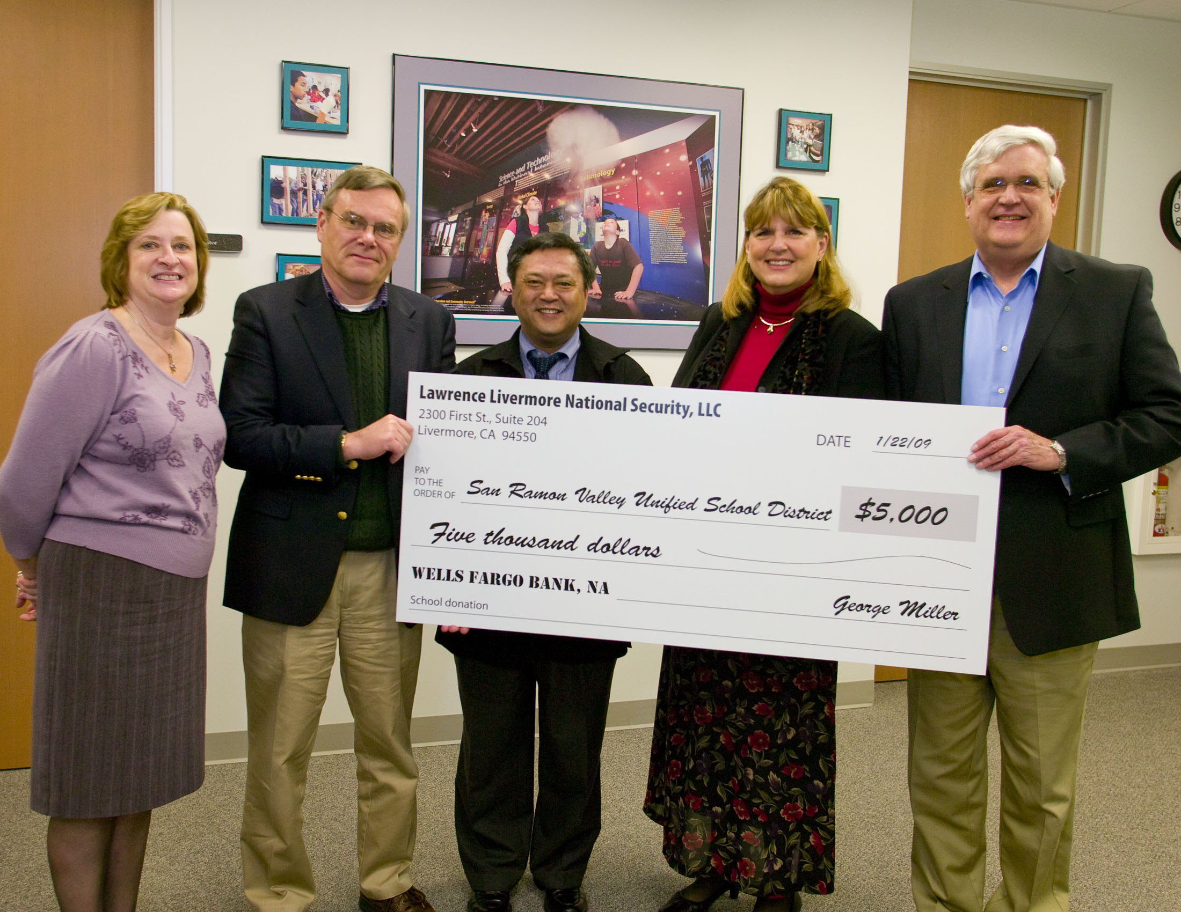
Get that Grant Money!

Slide 2
Contact Us
Damon Tighe
Leigh Brown
Tamica Stubbs
Aaron Kallas

Slide 3
Join Us! Share your Successes!
@BioRadEducation
pinterest.com/teachbiology
@BioRadEducation

Slide 4
Workshop Outline
How to write a grant
How to design a program
How to search for funding

Slide 5
Workshop Goals
All participants will leave ready to apply for a grant.
Understand the requirements and components of grants.
Build an action plan.
Gain confidence (with a little practice)

Slide 6
Getting Started
Grant Toolkit:
Sample Letter of Support
Sample Proposal
Sample Budget & Narrative

Slide 7
Proposal Process
Identify and contact team
Identify Need
Design Program
Find a funding source
Writing Proposal

Slide 8
Putting Your Team Together
Administrator
Counselor
Assessment coordinator
Community relations officer
Industry / community member
Key teachers
4 – 7 members is ideal, smaller grants should have smaller teams

Slide 9
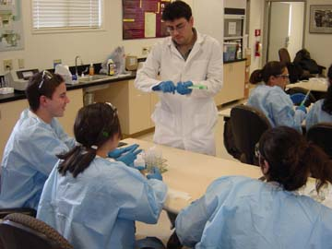
Identify Need
Establish the Need…
Increase Rigor
Skill Building
Increase Relevance
CTE/AP/IB

Slide 10
Quick Write
Your administrator walks into your room and says that she has some extra money and would like you to write her a paragraph explaining how you would use the funds.
It is $5,000–$10,000
You have 5 min… Go…

Slide 11
Share with your neighbor
Turn to your elbow partner and share what you have written.

Slide 12
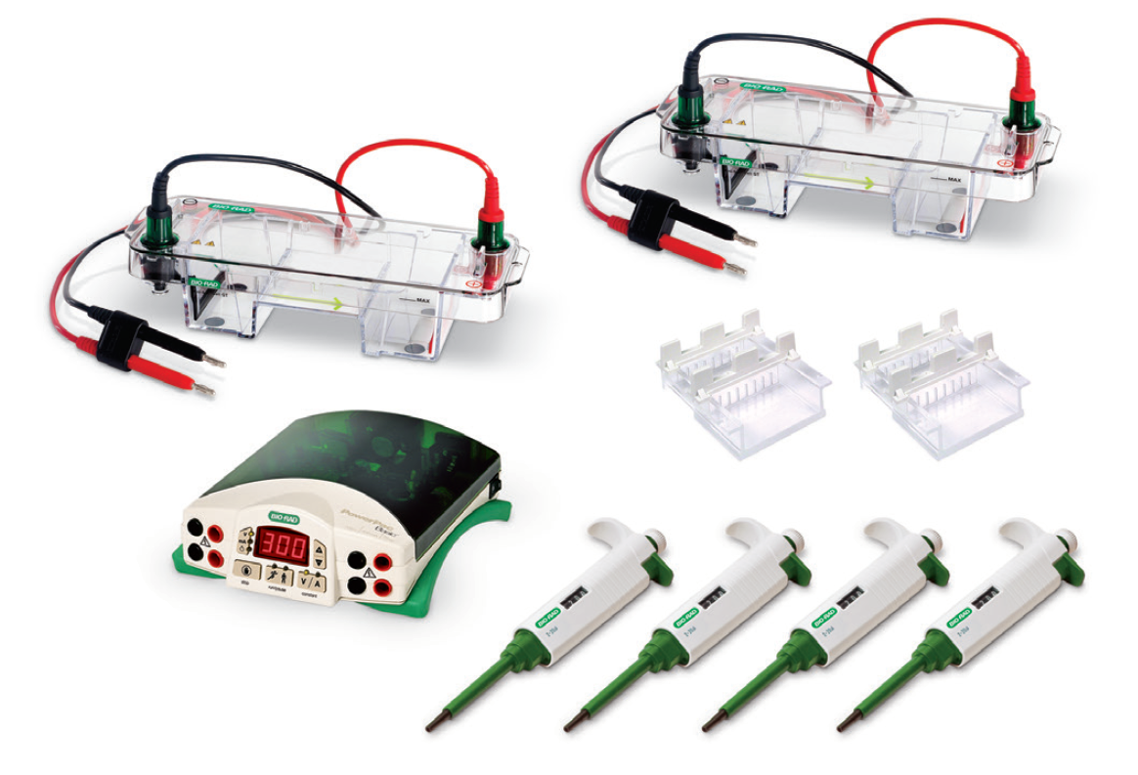
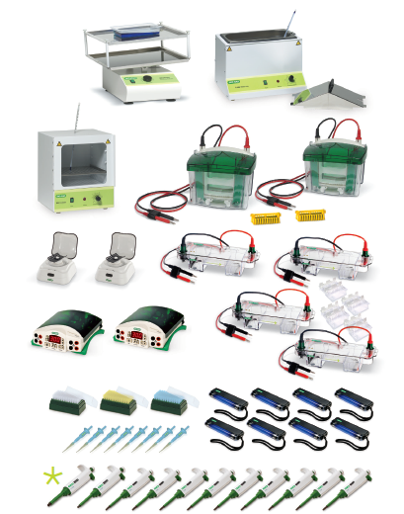
Designing Your Program (Vision)
Identifying what you need
Scaling model: “demo to deluxe”
Partnerships/collaborations
Colleges & Universities (incl. CC)
Business & industry (incl. small business)
Service & non-profit organizations
Other schools/district
Parents & community

Slide 13
Writing a Proposal
General Information
Sources of Information
School Accountability Reports
District Reports
School Plan
WASC
National/State Assessments
Counselors, Public Affairs Officers, Assessment Coordinators

Slide 14
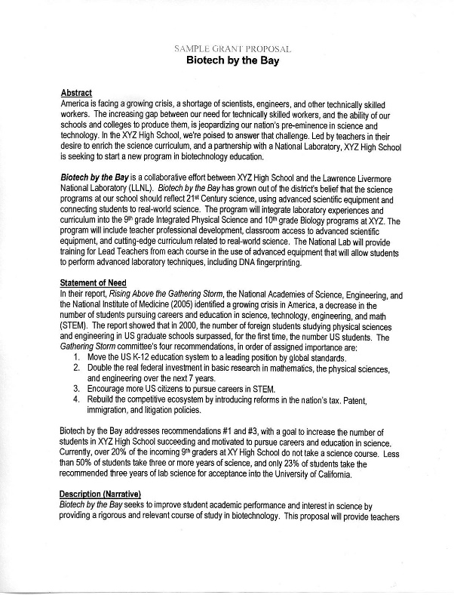
Writing a Proposal
Proposal Outline – Sample
Need
Abstract
Description
Evaluation
Budget & Justification – Sample
Letter of support – Sample

Slide 15
Writing a Proposal
Abstract
Write after completing description
Provide complete, but generalized overview of program
Suitable for press-release
Not always required

Slide 16
Writing a Proposal
Description / Narrative
What you will do
Who will do it
Timeline
Be explicit, particularly regarding what students will be doing
Charts can help reduce wording, if space is a limitation
Sustainability

Slide 17
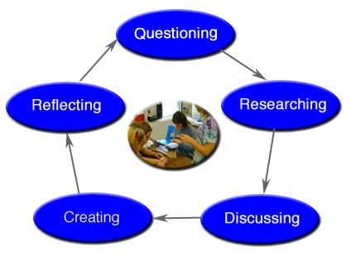
Writing a Proposal
Evaluation
How will you document whether the project met its goals?
Formative and summative evaluations
Web-based data management systems
Do not over-commit to a level of evaluation you cannot provide
Data should be used as part of a “cycle of inquiry” to provide for “continuous improvement”

Slide 18
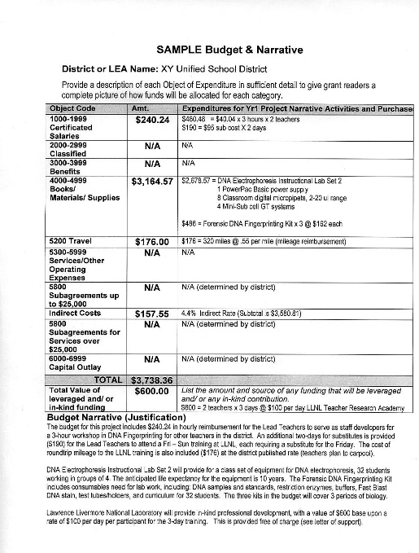
Writing a Proposal
Budget / Justification
Consult with vendors for quotes
Don’t stress, most grants will allow 10–15% in changes
Use your school accountant or district business services for important info such as school codes, tax ID, indirect rates, etc.

Slide 19
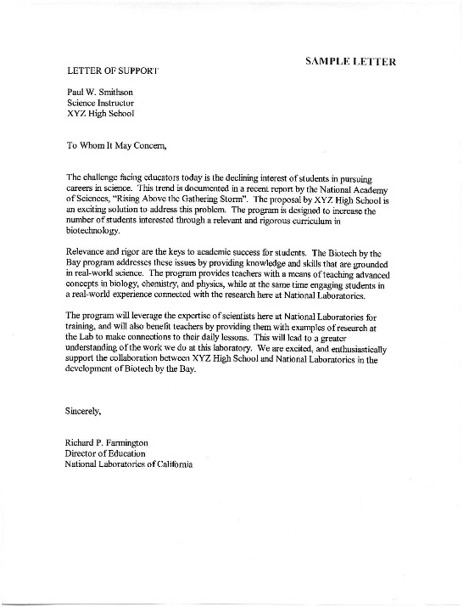
Writing a Proposal
Letter of Support
Ask early (minimum 2-weeks) and always offer to provide a sample
Let them know if there are formatting requirements
Differentiate as to level of involvement:
Supporters vs. partners

Slide 20
Writing a Proposal
Tips for a successful proposal
Follow format guidelines
Submit proposal on time
Stay focused, don’t overcommit
Stay within budget limits
Include in-kind contributions
Remember, only grants that are submitted will be funded!!

Slide 21
Design cont’d
Design your program with flexibility in mind
Plan for growth

Slide 22
Sources of Funding
Awards
Scholarships
Grants

Slide 23
Levels of Grants
State / National
Higher funding levels
Highly competitive / complex proposals
Higher level of accountability/evaluation
Local
Small / mini-grants ($200–$5,000)
Short proposals 2–7 pages
Local area (local-focus grants)
Build upon local relationships & partners
Site-based, district, county, regional

Slide 24
Search Strategies
District Office — directors / coordinators
County Office — newsletters / web sites
Professional Journals / web sites
Online
NSTA
State Science Teachers
County Office of Education
Google
Science product company websites (e.g. Bio-Rad Laboratories Educator Grant)

Slide 25
Search Strategies
Grants Alert (www.grantsalert.com)
Teachers Network (www.teachersnetwork.org)
Web search
Key words: grants, education, foundation, science, __state, __city

Slide 26
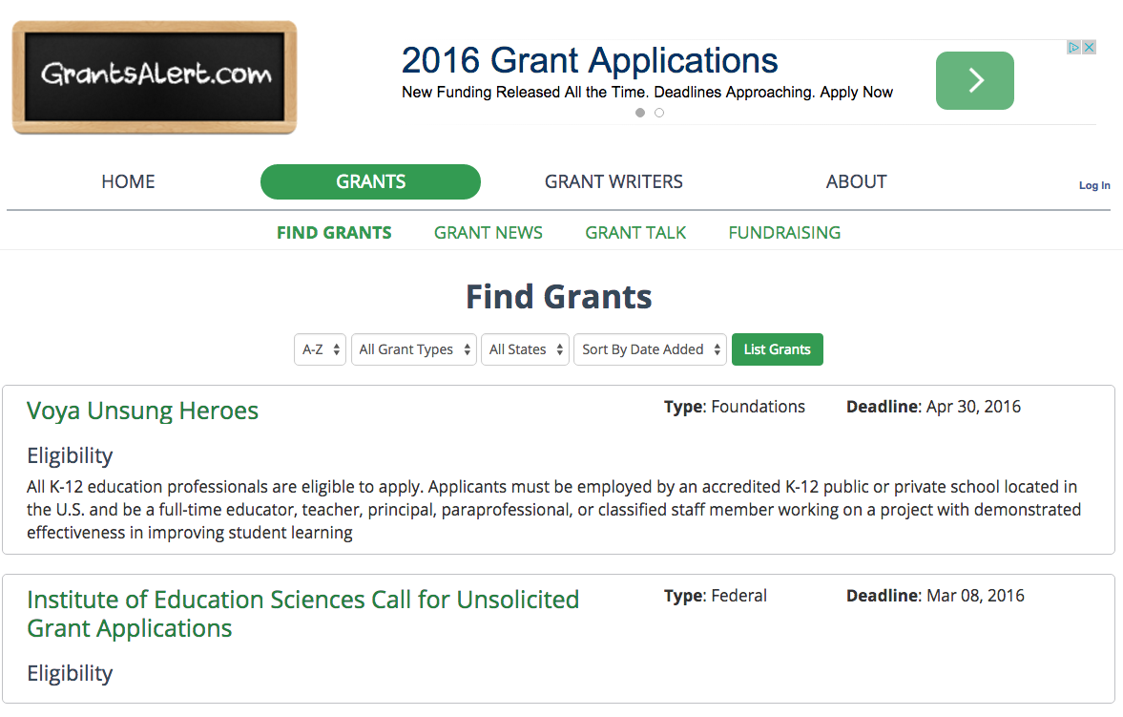

Slide 28
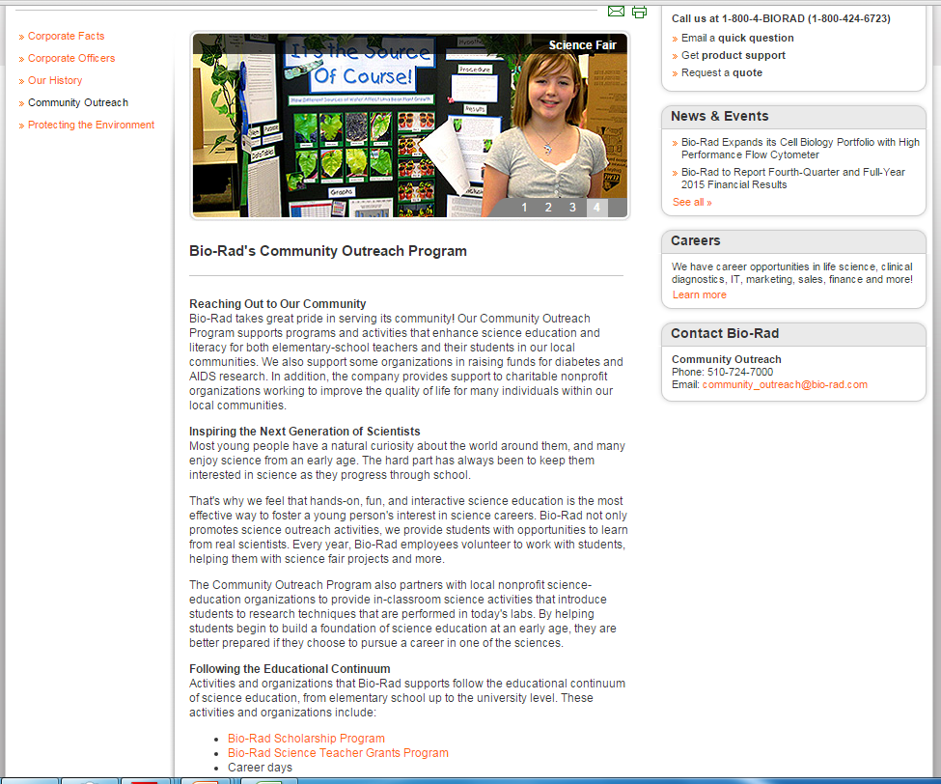

Slide 29
More Grants
Grant Sources
Lowes Small Grant Program
RGK Foundation Education Grants
Lockheed Martin STEM Education Grants
Walmart Community Grants
Target Grants
Donors Choose
Costco Charitable Giving
American Electric Power Grants
AT&T Aspire

Slide 30
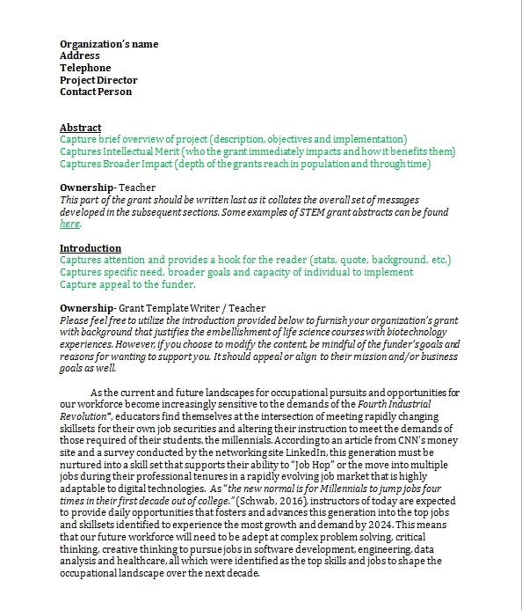
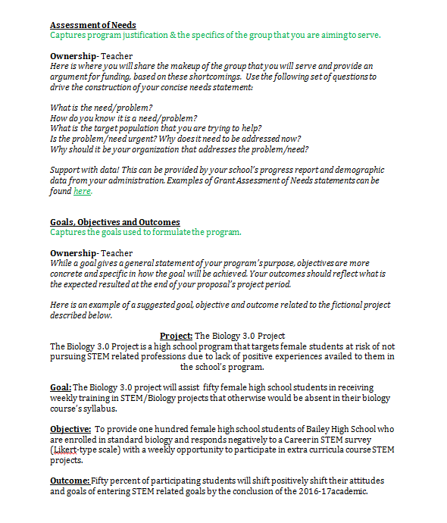
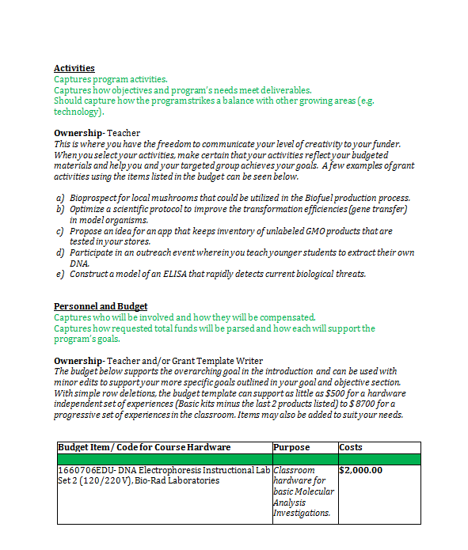
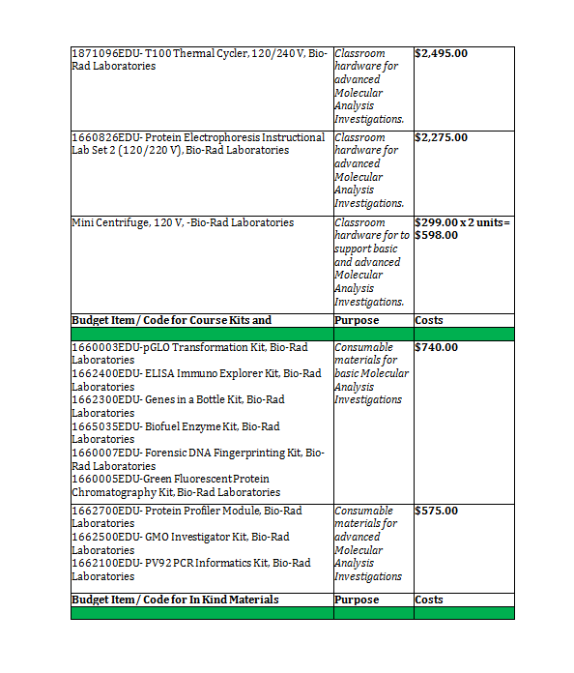
Grant Template

Slide 31
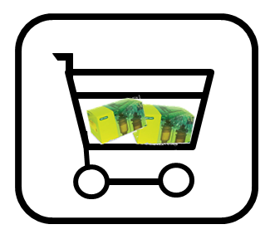
Where can I buy Bio-Rad Explorer kits and equipment?

