Slide 1
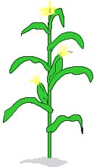
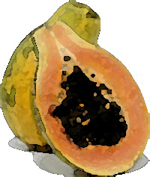
The GMO Debate
Bio-Rad Biotechnology Explorer™ GMO Investigator

Slide 2
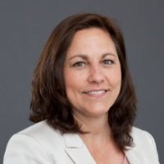
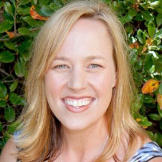
Instructors - Bio-Rad Curriculum and Training Specialists
Damon Tighe
damon_tighe@bio-rad.com
Tamica Stubbs
Tamica_stubbs@bio-rad.com
Sherri Andrews, Ph.D.
sherri_andrews@bio-rad.com
Leigh Brown
leigh_brown@bio-rad.com

Slide 3
Bio-Rad Resources
@BioRadEducation
Biotechnology: A Lab Skills Course
Pinterest.com/teachbiology
bit.ly/b-rdropbox

Slide 4
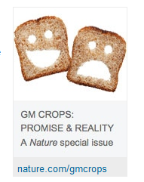
GMO’s in the News

Slide 5
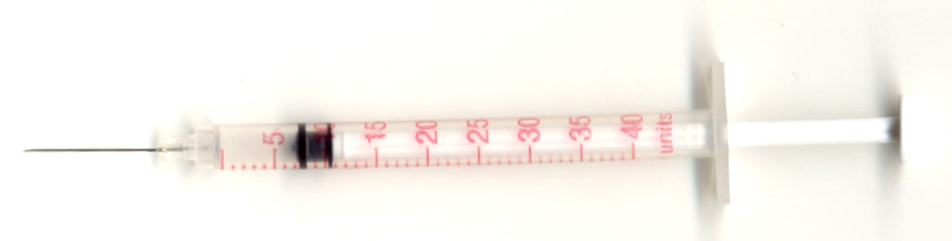
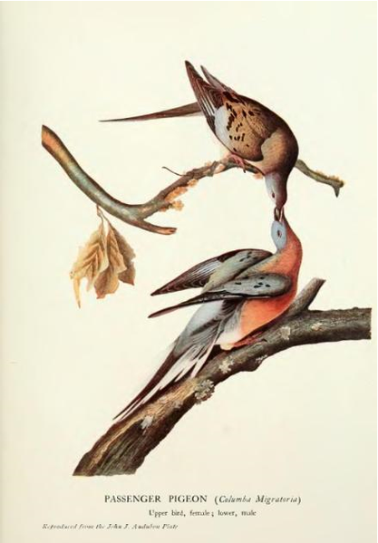
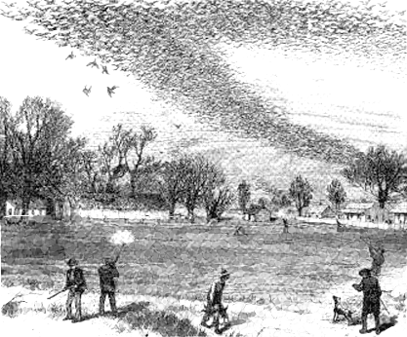
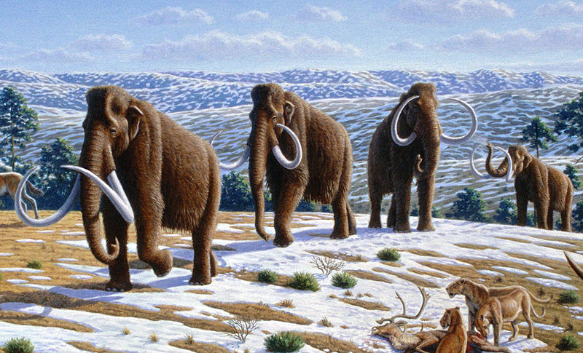
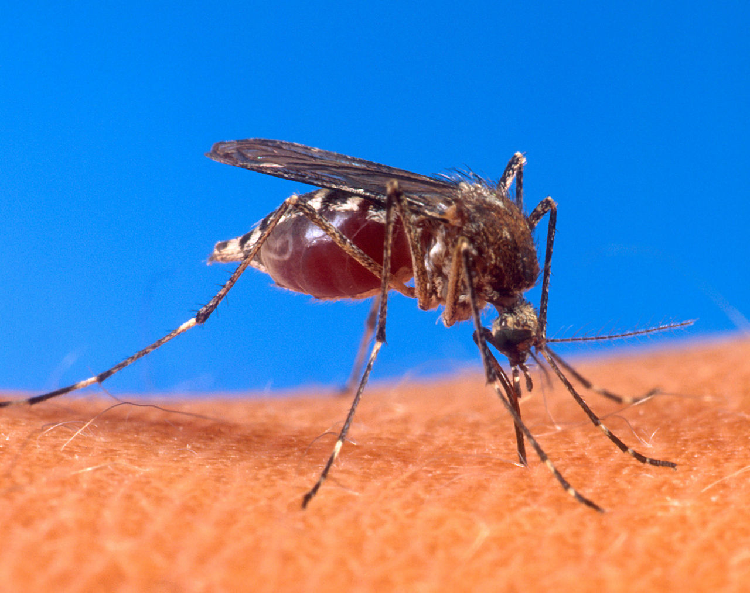
Beyond food GMOs
Recombinant DNA Technologies
Insulin
De-extinction Projects
Woolly Mammoth
Passenger Pigeon
Re-Wilding
Eastern Chestnut
Backcross with Chinese chestnut?
Move 4 genes in to give resistance?
Synthetic Bio
Artemisinic acid production to treat malaria
Synthetic life - JCVI-syn1.0 completely man made genome
- Chassis to produce any material we see made by organisms
Notes:
Insulin – use to get it from pigs, but 1970s more diabetics coming on the scene than pig pancreases and slaughter houses so Genentech using recombinant DNA technology starts producing insulin in E.coli
De-Extiniction Projects – most of them are under the idea that humans wiped out these ecology terraforming organisms and we should bring them back
Wooly Mammoth – as polar ice leaves the tundra is letting off tons of methane, a really strong global warming gas, however if we could convert tundra into grasslands again it would slow the methane release, so a group is very interested in bringing back a Woolly Mammoth like creature that could help this cold climate grasslands. We have good DNA from frozen specimens and seeds that were beneath the ice are already beeing harvested and grown
Passenger Pigeon – will probably be the first successful american de-extinction project since the DNA we have is relatively fresh. The last passenger pigeon, Martha died in the Cleveland Zoo in 1914. The passenger pigeon use to black out the sky because there were so many of them and the most likely greatly influenced the structure of east coast forests.
Re-Wilding - http://www.nature.com/news/plant-science-the-chestnut-resurrection-1.11504
Eastern chestnut trees use to dominate eastern forests but were wiped out by a blight (Phytophthora cinnamomi) at the turn of the last century. If you back cross the north american eastern chestnut with the chinese chestnut you can make it resistant to the blight, but it brings in thousands of genes from the chinese species without control. If you use modern molecular bio techniques you can move over just 1 gene from wheat to disarm the phytophthora. Which one should we re-introduce to the wild???
Synthetic Biology – branch of biology where we are basically programming life forms to product things we want
Artemisinic acid – the most powerful starting compound for making anti-malarial drugs, but price is usually high and supply in unstable since its derived from south east asian wormwood. Under LOTS of Gate Foundation money, Jay Keasling at Berkeley National lab moved an entire pathway of genes from the wormwood into yeast, so that the cost to produce the drugs should be low enough to help people in the developing world
Synthetic life – Craig Venter of Human Genome Project fame in 2010 made the first synthetic organism by synthesizing an entire chromosome using organic chemistry and some molecular biology tricks. The group put the man made chromosome inside of a bacteria and deleted out its genome which caused the cell to “reboot” as a new life form. This is the start of the first chassis upon which now we can build other pathways. Venter ultimately wants to make everything we make from petrol from bacteria that are fed sunlight and poop out the good stuff.

Slide 6
Safe and Accurate Food Labeling Act of 2015
FOOD DERIVED FROM NEW PLANT VARIETIES.
IN GENERAL:
the use of genetic engineering does not, by
itself, constitute information that is material for
purposes of determining whether there is a difference between a food produced from, containing,
or consisting of a genetically engineered plant and a
comparable food.

Slide 7
LABELING REQUIRED if
there is a material difference in the
functional, nutritional, or compositional characteristics, allergenicity, or other attributes between the food so produced and its comparable food
And
the disclosure of such material difference is necessary to protect public health and safety or to prevent the label or labeling of the food so produced from being false or misleading in any particular.’

Slide 8
If your food contains any of the following it may contain some genetically modified crop
Soybean
Corn
Cotton
Canola
sugar beet
And this includes processed foods

Slide 9
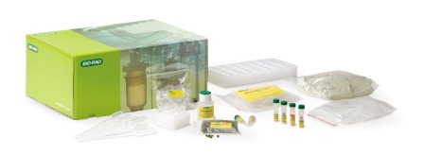
How can you test your food for GMO?
GMO Investigator Kit
Extract and amplify DNA from different food samples
Perform genuine diagnostic procedures
Use PCR and electrophoresis to find GMO foods
Notes:
If you knew the protein you were looking for you could also use an ELISA

Slide 10
Kit Extension
GMO Debate
Straw poll
How many of you support GMO foods?
How many of you are against GMO foods?
Neutral?

Slide 11
Debate Format For
Opening Statement: Supporters of GMO use present an opening statement outlining the
benefits of GMO crops (4 minutes)
Break: Opponents assemble a list of questions they believe shows holes in the supporters
argument (2 minutes)
Questions: Opponents present questions (2 minutes).

Slide 12
Debate Format Opponent
Opening Statement: Opponents of GMO present an opening statement outlining the
reasons why GMO crops should not be allowed (4 minutes).
Break: Supporters assemble a list of questions they believe shows holes in the opposition's
argument (2 minutes).
Questions: Supporters present questions (2 minutes).

Slide 13
Debate Format
Rebuttal: Supporters present answers to opponents' questions (2 minutes).
Rebuttal: Opponents present answers to proponents' questions (2 minutes).
Closing arguments: opposing view (3 minutes).
Closing arguments: supporting view (3 minutes).

Slide 14
Variation for today
In December of 2014 Intelligence Squared U.S. hosted a GMO debate in New York City at the Kaufman Center. The key players were a genetics professor and Monsanto's chief technology officer. We will use this video as a model for what an opening statement looks like for both proponents and opponents.
http://www.popsci.com/head-head-gmo-debate-win-gm-foods
Right side of the room –supporters
Left side of the room - opponent

Slide 15
Variation from classroom debate
We will watch support presentation (~8 min of video.)
Provide time for evaluation and discussion among participants (10 min).
Pro team will list strengths of presentation
Con team will generate questions

Slide 16
Opponent Presentation
We will watch proponent presentation (~8 min of video.)
Provide time for evaluation and discussion among participants (10 min).
Con team will list strengths of presentation
Pro team will generate questions

Slide 17
Proponent
GMO Pro.mp4

Slide 18
Opponent
con gmo.mp4

Slide 19
Question Presentation
Con to pro (2 min)
Pro to con (2min)
5 minute interval to choose question answers in teams
Pose questions to opposing
5 minutes to identify what evidence you would need to find to answer questions presented / defend
What does that evidence look like?

Slide 20
Importance in Choosing Defense
You must be able to provide EVIDENCE from a reputable source
You can not use phrases“We think” “We believe” “We Feel”
You must be able to provide documentation of your sources of evidence

Slide 21
Rubric

Slide 22
Generating Scientific Evidence
GMO Investigator Kit Allows Students to:
Test for GMOs by PCR:
Grind food
Extract DNA from sample
Test sample DNA for viable plant DNA
Test sample DNA for genetic modifications
Gel Electrophoresis to verify PCR products

Slide 23
Kit Highlights
Bio-Rad certified non-GMO food
Verify PCR is not contaminated
GMO positive control DNA
Verify GMO-negative result is not due to PCR reaction not working properly
Primers to universal plant gene (Photosystem II)
Verify viable DNA was extracted

Slide 24
Why Amplify a Plant Gene?
To confirm that viable DNA was extracted and that negative GM result isn’t due to a non-viable template.
Use highly conserved chloroplast gene from Photosystem II – part of the light reaction of photosynthesis.

Slide 25
Primer Sets
CaMV 35S – Sequence for the promoter of 35S transcript of the Cauliflower mosaic virus.
Used because it functions in every plant cell
NOS- Sequence for nopaline synthase terminator from soil bacterium Agrobacterium tumefacians
Used because it evolved to be recognized in most plants

Slide 26
GMO?
Analysis of Results
1
2
3
4
5
6
7
GMO positive
1: non-GMO food with plant primers
2: non-GMO food with GMO primers
3. Test food with plant primers
1
2
3
4
5
6
7
4: Test food with GMO primers
5: GMO positive template with plant primers
6: GMO positive template with GMO primers
GMO negative
7: PCR MW Ruler

Slide 27
GMO Investigator Advantages
Develop and Use Models
Engage in Argumentation from evidence
Ask Questions and Define Problems
Plan and Carry Out Investigations
Analyze and Interpret Data

Slide 28
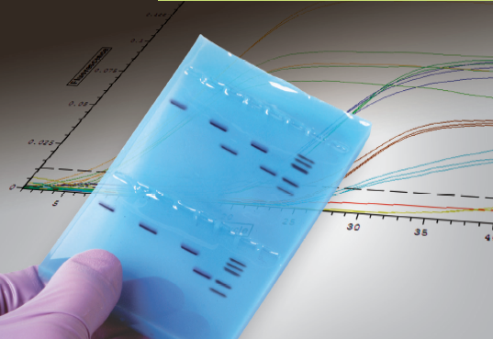
Straw Poll
How many of you support GMO foods?
How many of you are against GMO foods?
Neutral?

