Slide 1
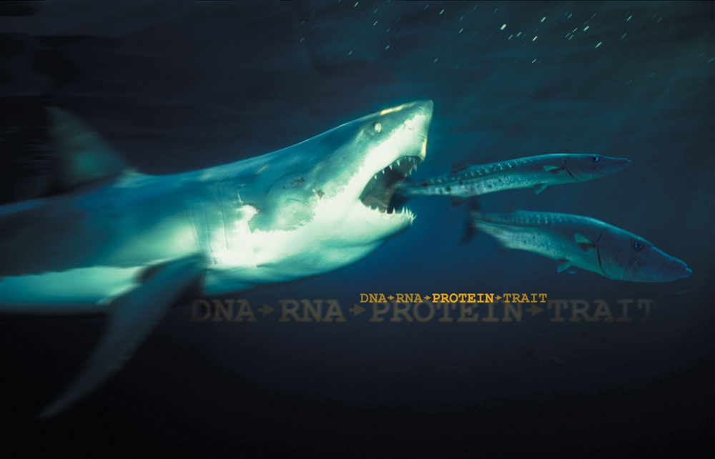
Exploring Molecular Evolution using Protein Electrophoresis
Is there something fishy about evolution?
Bio-Rad Biotechnology Explorer Comparative Proteomics Kit I: Protein Profiler Module

Slide 2
Instructors - Bio-Rad Curriculum and Training Specialists
Sherri Andrews, Ph.D., Eastern US
sherri_andrews@bio-rad.com
Damon Tighe, Western US
damon_tighe@bio-rad.com
Leigh Brown, M.A., Central US
leigh_brown@bio-rad.com

Slide 3
Workshop Timeline
Introduction
Sample Preparation
Load and electrophorese protein samples
Compare protein profiles
Construct cladograms
Stain polyacrylamide gels
Laboratory Extensions

Slide 4
Traditional Systematics and Taxonomy
Classification
  Kingdom
  Phylum
  Class
  Order
  Family
  Genus
  Species
Traditional classification based upon traits:
  Morphological
  Behavioral

Slide 5

Biochemical Similarities
Traits are the result of:
  Structure
  Function
Proteins determine structure and function
DNA codes for proteins that confer traits

Slide 6
Biochemical Differences
Changes in DNA lead to proteins with:
  Different functions
  Novel traits
  Positive, negative, or no effects
Genetic diversity provides pool for natural selection = evolution

Slide 7
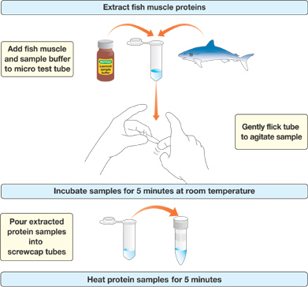
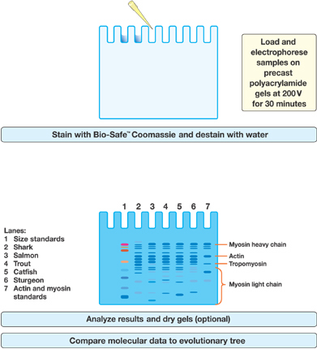
Protein Fingerprinting Procedures
Day 2
Day 1
Day 3

Slide 8
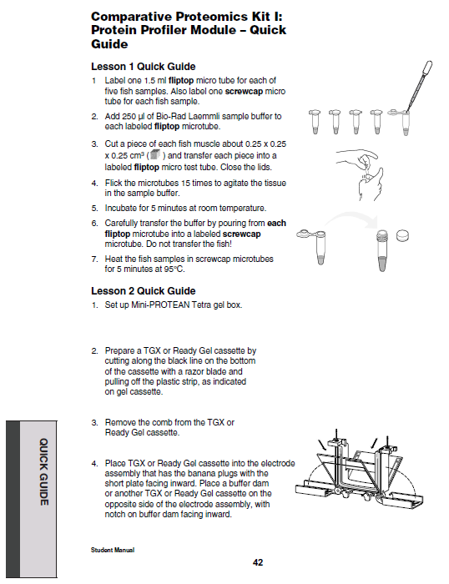
Laboratory Quick Guide

Slide 9
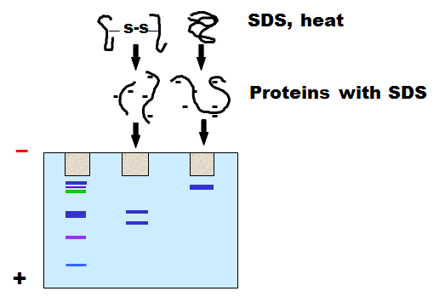
Why Heat the Samples?
Heating the samples denatures protein complexes, allowing the separation of individual proteins by size

Slide 10
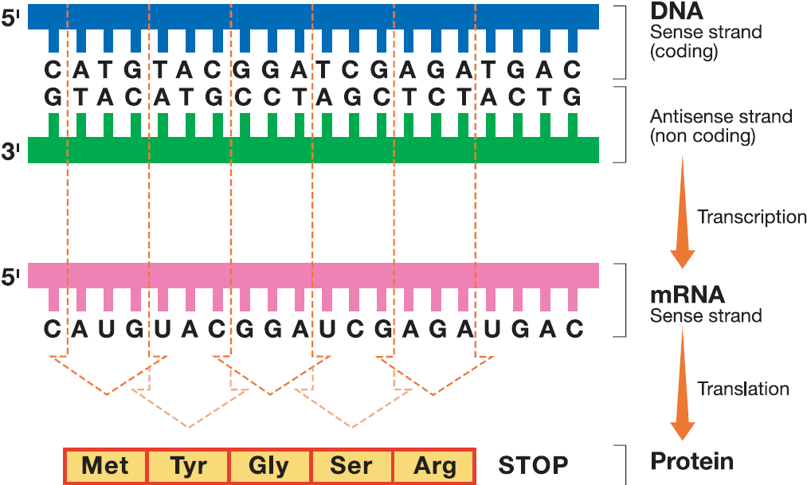

Slide 11
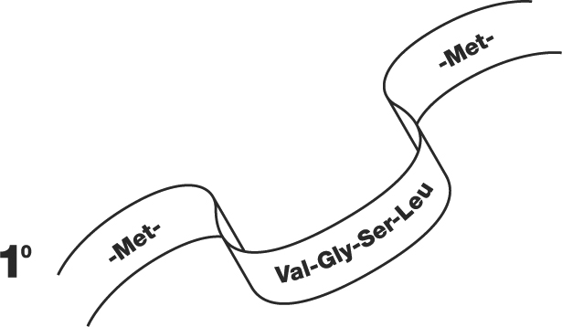
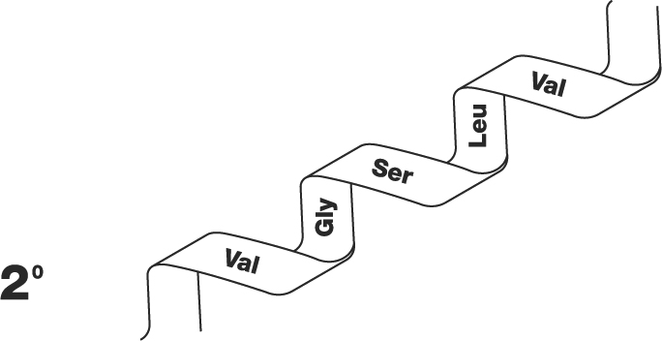
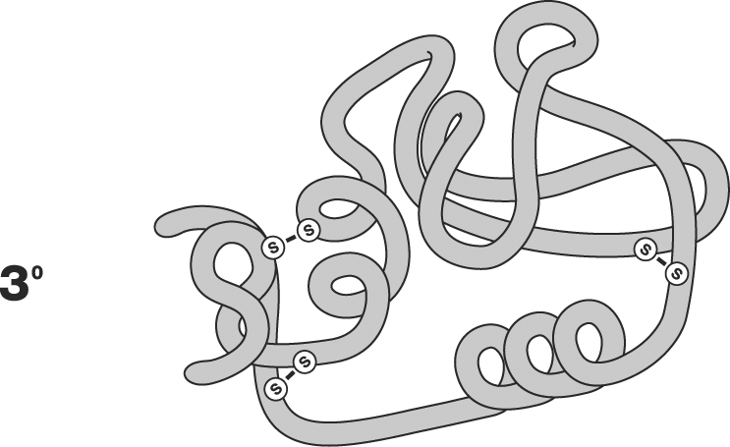
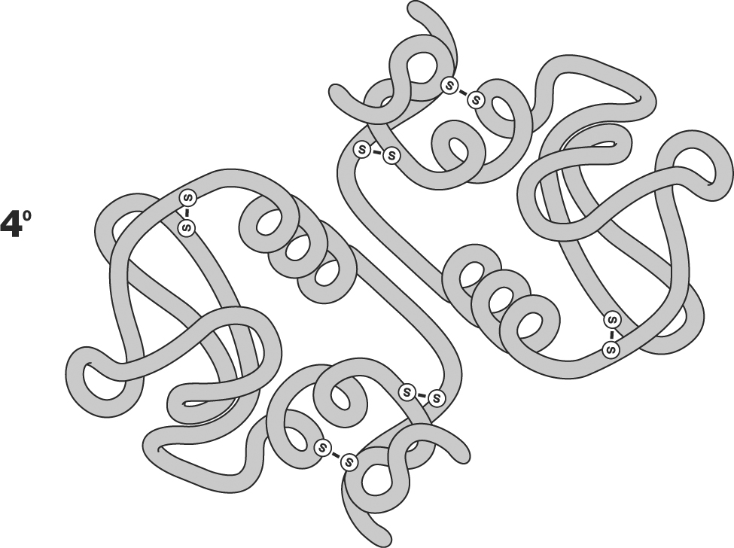
Levels of Protein Organization
1º
2º
3º
4º

Slide 12
Protein Size Comparison
Break protein complexes into individual proteins
Denature proteins using detergent and heat
Separate proteins based on size

Slide 13
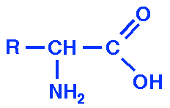
Protein Size
Size measured in kilodaltons (kD)
Dalton = approximately the mass of one hydrogen atom or 1.66 x 10⁻²⁴ gram
Average amino acid = 110 daltons

Slide 14
Muscle Contains Proteins of Many Sizes
Protein | kD | Function
Titin | 3000 | Center myosin in sarcomere
Dystrophin | 400 | Anchoring to plasma membrane
Filamin | 270 | Cross-link filaments
Myosin heavy chain | 210 | Slide filaments
Spectrin | 265 | Attach filaments to plasma membrane
Nebulin | 107 | Regulate actin assembly
α-actinin | 100 | Bundle filaments
Gelosin | 90 | Fragment filaments
Fimbrin | 68 | Bundle filaments
Actin | 42 | Form filaments
Tropomysin | 35 | Strengthen filaments
Myosin light chain | 15-25 | Slide filaments
Troponin (T.I.C.) | 30, 19, 17 | Mediate contraction
Thymosin | 5 | Sequester actin monomers

Slide 15
Actin and Myosin
Actin
  5% of total protein
  20% of vertebrate muscle mass
  375 amino acids = 42 kD
  Forms filaments
Myosin
  Tetramer
  two heavy subunits (220 kD)
  two light subunits (15-25 kD)
  Breaks down ATP for muscle contraction

Slide 16
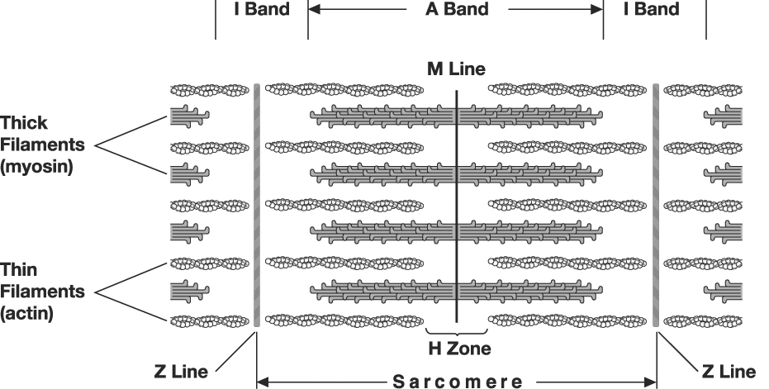
Actin and Myosin

Slide 17
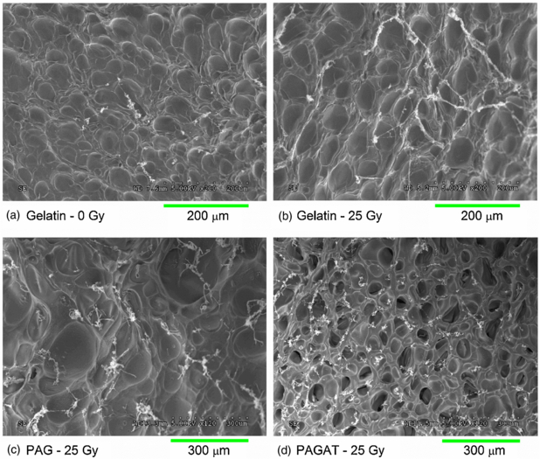
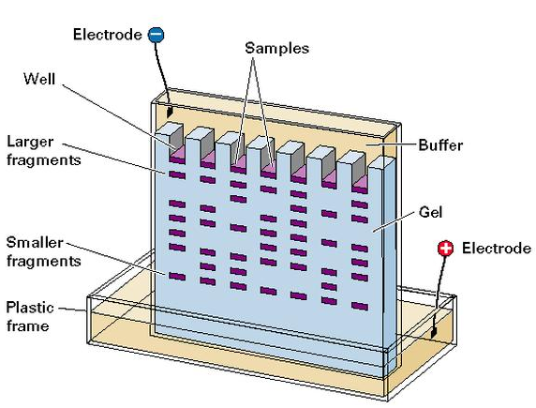
Separate Proteins: Load and run gels
SDS-PAGE gel separates proteins based upon their size
TGS Running buffer
Tris-HCL for buffering effect
Glycine for shielding during stacking
SDS – to make sure protein stays linear
  PAGE gels used for proteins, because they are much smaller than DNA
  Polyacrylamide gel 20-200nm pores
  3% agarose 40-80 nm pores
  1% agarose 200-1200 nm pores

Slide 18
Electrolysis always occurs during electrophoresis
Cathode produces H₂ at twice the rate that anode produces O₂
Current is carried by solute ions. Electrons aren’t soluble in H₂O.
Example: TAE buffer; tris supplies
cations (+), acetate
supplies anions (-)
Electrolysis occurs
at the electrodes

Slide 19
SDS-Polyacrylamide Gel Electrophoresis
CH₃
SDS-PAGE
SDS detergent (sodium dodecyl sulfate)
  Solubilizes and denatures proteins
  Adds negative charge to proteins
Heat denatures proteins
CH₂
CH₂
CH₂
CH₂
CH₂
CH₂
CH₂
CH₂
CH₂
CH₂
CH₂
O
O
S
O
-
SDS
O

Slide 20
Chemistry in action…. detergents

Slide 21
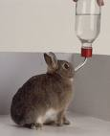
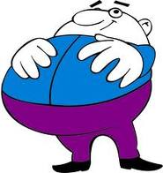
Detergents…
are amphiphiles, containing a lipophilic portion and a hydrophilic portion
lower the interfacial energy between unlike phases
emulsify or solubilize aggregated particles
I like fat!
I like water!

Slide 22
More about detergent terms
Lipophilic portion is also referred to as “hydrophobic” tail
Hydrophilic portion is also referred to as “polar” head
Types: nonionic, anionic, cationic and zwitterionic

Slide 23
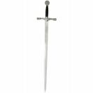
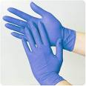
Detergents: Ionic vs non-ionic
Denaturing vs non-denaturing
Swords (denaturing): “pointy” hydrophobic ends, ionic polar ends
Gloves (non-denaturing): bulky,
non-penetrating hydrophobic ends,
non-ionic or zwitterionic polar ends
SDS
Triton X-100

Slide 24
Why Use Polyacrylamide Gels to Separate Proteins?
Polyacrylamide gel has a tight matrix
Ideal for protein separation
Smaller pore size than agarose
Proteins much smaller than DNA
  Average amino acid = 110 daltons
  Average nucleotide pair = 649 daltons
  1 kilobase of DNA = 650 kD
  1 kilobase of DNA encodes 333 amino acids = 36 kD

Slide 25
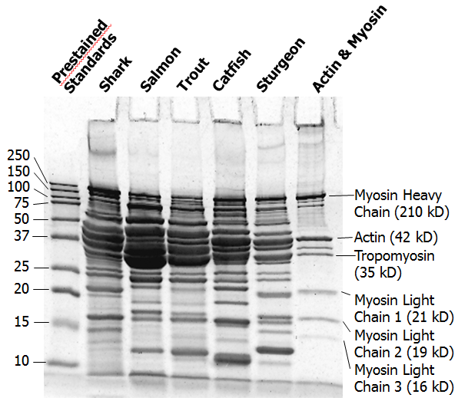
Polyacrylamide Gel Analysis

Slide 26
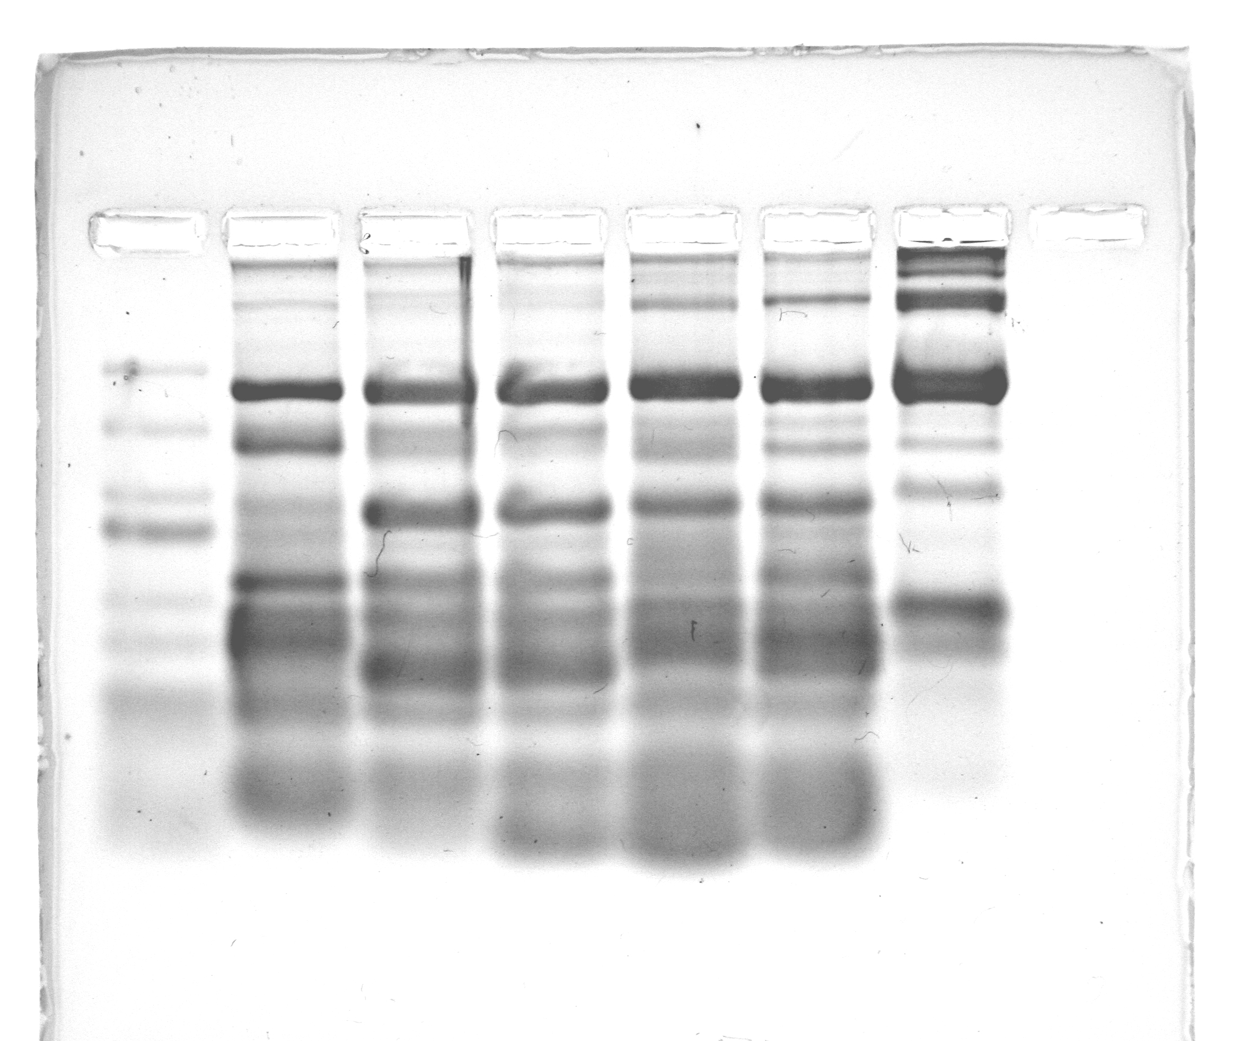
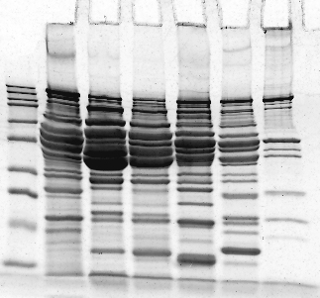
Can Proteins be Separated on Agarose Gels?
Prestained
Standards
Actin & Myosin
Prestained
Standards
Actin & Myosin
Salmon
Sturgeon
Shark
Salmon
Catfish
Sturgeon
Shark
Trout
Catfish
Trout
250
150
250
100
Myosin Heavy Chain
150
Myosin Heavy Chain
75
50
100
37
Actin
75
25
Tropomyosin
50
Actin
20
37
Tropomyosin
Myosin Light Chains
25
Myosin Light Chains
15
20
10
Polyacrylamide
Agarose

Slide 27
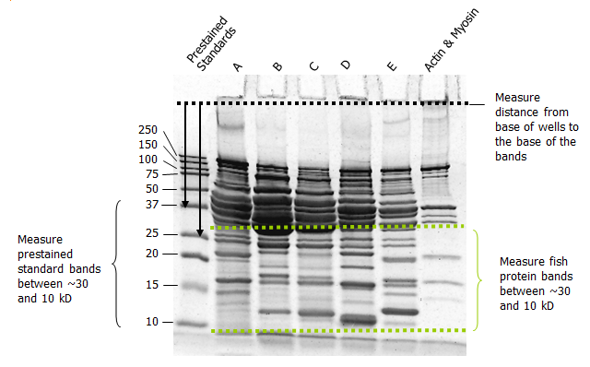
Determine Size of Fish Proteins

Slide 28
Molecular Mass Estimation
37 (12 mm)
25 (17 mm)
20 (22 mm)
15 (27.5 mm)
10 (36 mm)

Slide 29
Molecular Mass Analysis With Semi-log Graph Paper

Slide 30
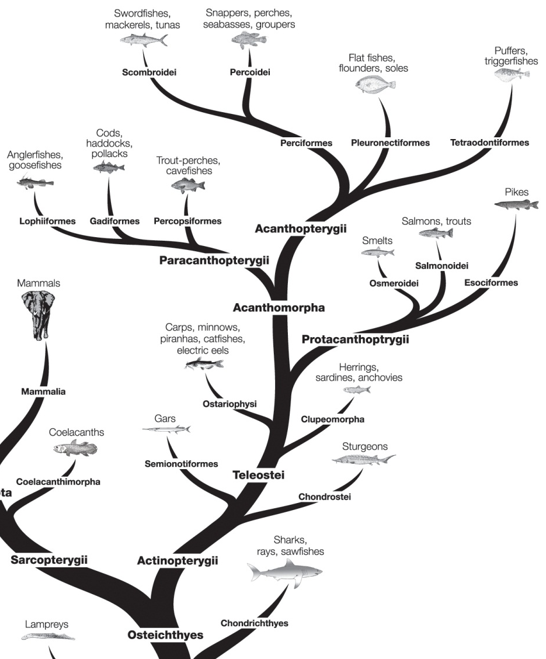
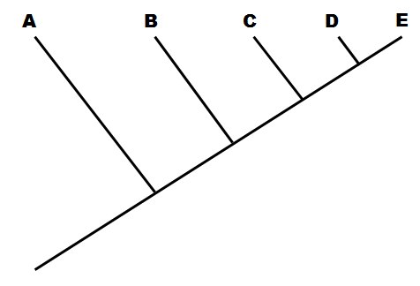
Using Gel Data to Construct a Phylogenetic Tree or Cladogram

Slide 31
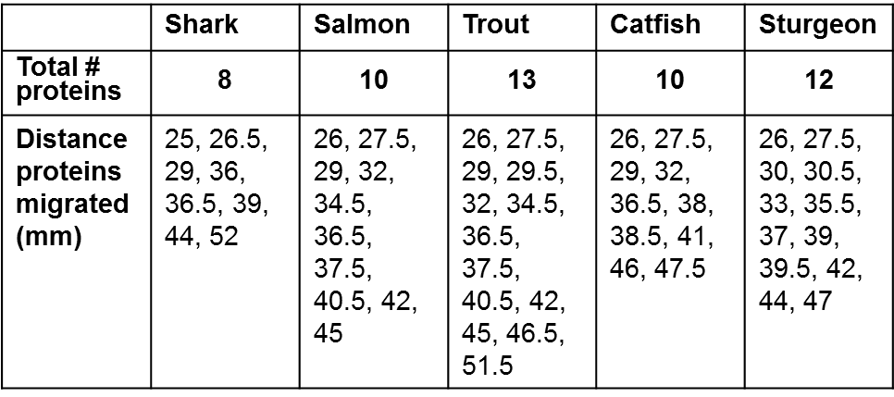
Each Fish Has a Distinct Set of Proteins

Slide 32
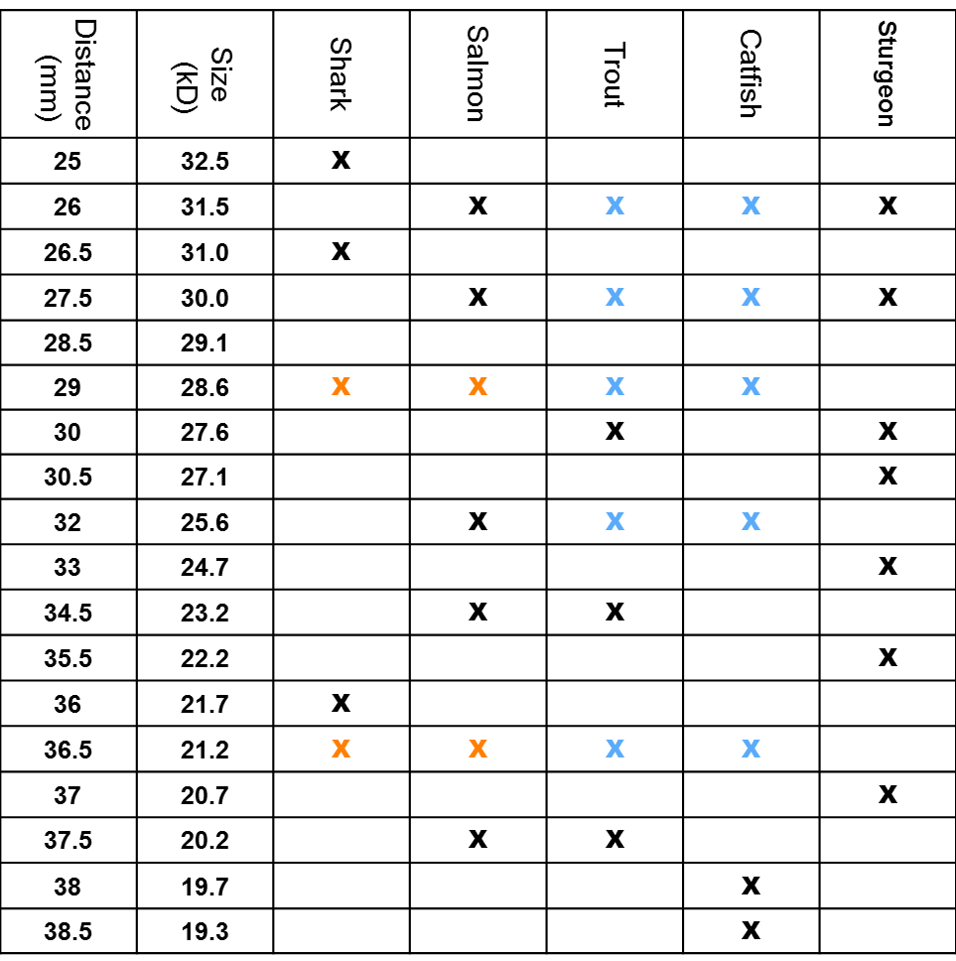
Some of Those Proteins Are Shared Between Fish

Slide 33
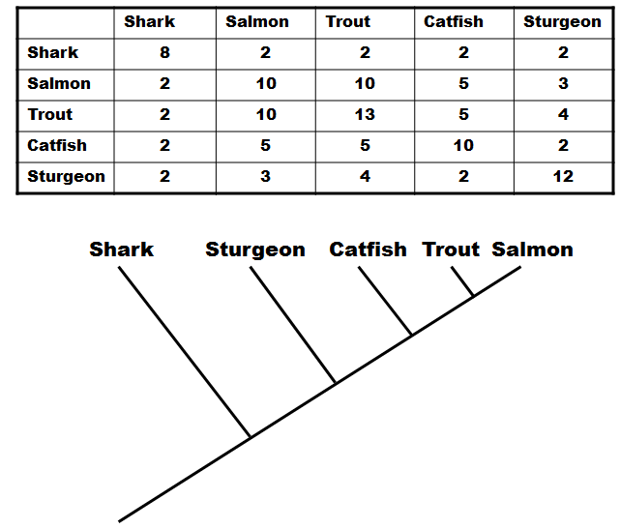
Character Matrix Is Generated and Cladogram Constructed

Slide 34
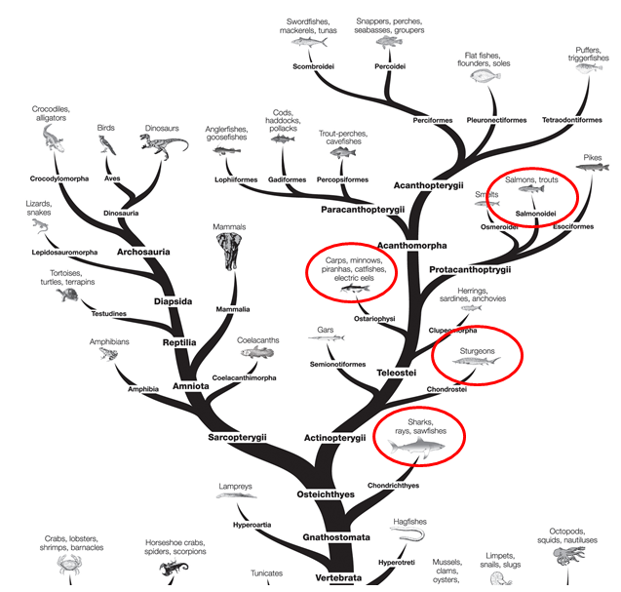
Phylogenetic Tree
Evolutionary tree showing the relationships of eukaryotes. (Figure adapted from the tree of life web page from the University of Arizona (www.tolweb.org).)

Slide 35
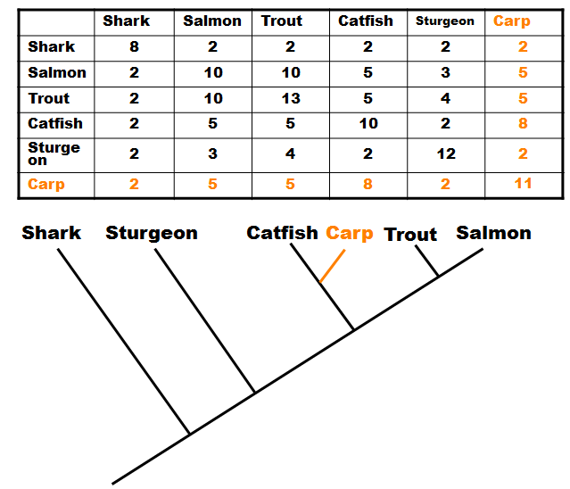
Pairs of Fish May Have More in Common Than to the Others

Slide 36
Student Inquiry
Questions to consider:
  How important is each step in the lab protocol?
  What part of the protocol can I manipulate to see a change in the results?
  Possible variables / questions:
    What happens if you don’t heat samples?
    Can you extract more protein from samples?
    Change buffer / agarose / TGX gel concentration
  How do I insure the changes I make is what actually affects the outcome (importance of controls).
  Write the protocol. After approval – do it!

Slide 37
Student Inquiry - More Advanced Questions
Can I use other organisms (plants, insects)?
Can I construct a cladogram based on my data from other organisms?
Can I compare amino acid sequences from other proteins

Slide 38
Student Inquiry - Teacher Considerations
What materials and equipment do I have on hand, and what will I need to order?
  Extra gels, different organisms?
  Other supplies depending on student questions
  Consider buying extras in bulk or as refills – many have 1 year + shelf life.
What additional prep work will I need?
  Order supplies

Slide 39
Student Inquiry - Teacher Considerations
How much time do I want to allow?
  Limited time? Have students read lab and come up with inquiry questions and protocol before they start. Collaborative approach.
  Will you need multiple lab periods?
  Will everyone need the same amount of time?

Slide 40
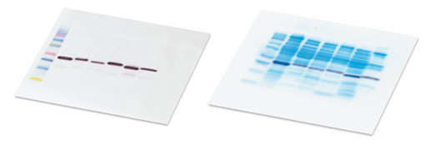
Extensions
Independent study
Western blot analysis

Slide 41
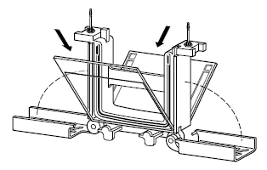
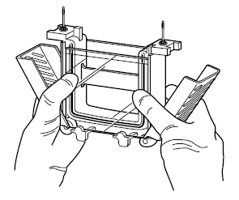
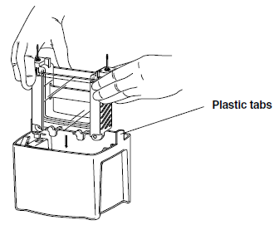
Mini-PROTEAN® Tetra gel chamber
Step 1
Step 2
Step 3

