Slide 1
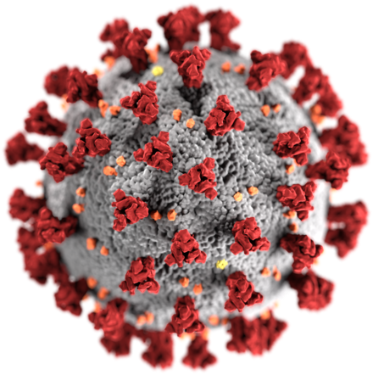
Detection Methods for SARS-CoV-2

Slide 2
SARS-CoV-2 Infection Timeline
Which analytes are from the virus?
Which are from the patient?
Which analyte(s) would be the most useful for detection:
during the onset of symptoms?
after recovery?
This graph is for illustrative purposes only - each type of infection has its own specific timeline.

Slide 3
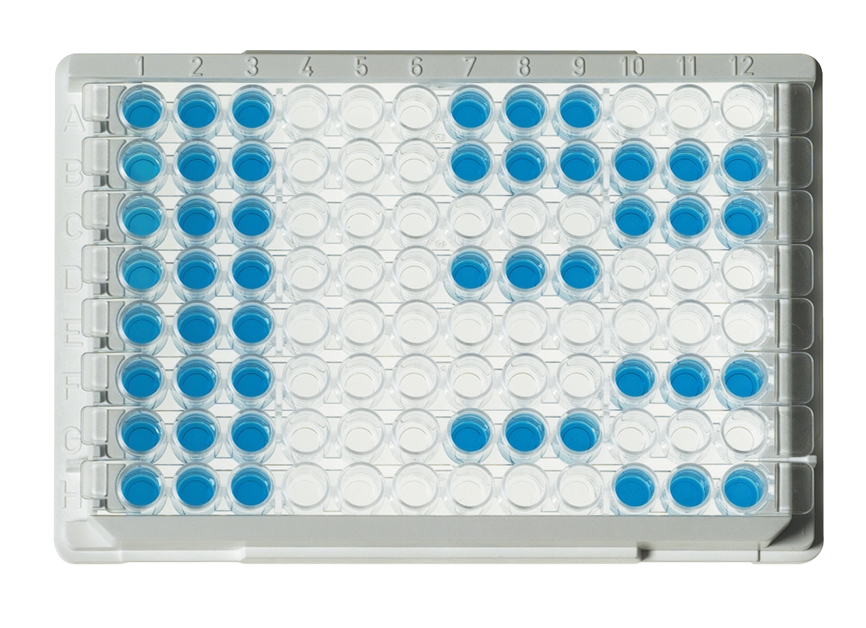
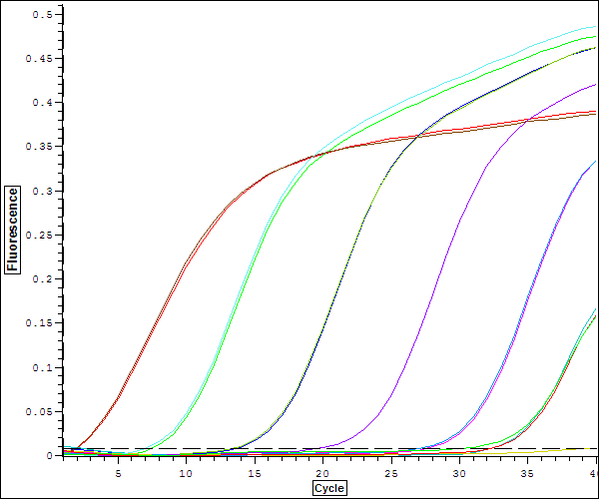
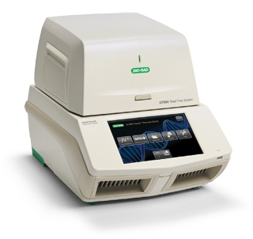
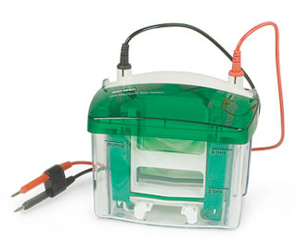
Detection and Identification Techniques
For RNA
Reverse transcription (RT) PCR
Real-Time RT PCR
Droplet digital PCR (ddPCR)
CRISPR
For antigen proteins
Antigen detection ELISA
SDS-PAGE
Western Blotting
For antibodies
Antibody detection ELISA
Notes:
See the FDA’s list of currently approved diagnostic tests
https://www.fda.gov/medical-devices/emergency-situations-medical-devices/emergency-use-authorizations#covid19ivd

Slide 4
Considerations when Developing a Test
Cost — how much does a test cost to develop and run?
Development time — how long will it take to develop?
Speed — Can test results be delivered at point of care (POC) or does the test require centralized analysis and sample shipment?
Samples — how easy/invasive to gather samples?
Instrumentation — is special equipment required?
Specificity — how well does a test detect only the target of interest?
Sensitivity — how well does a test detect low amounts of the target of interest?
How would you prioritize these considerations when designing a test?

Slide 5
Trade-Offs
Specificity vs sensitivity
False positive — positive test results for someone not infected; can happen with low specificity tests
False negative — negative test results for someone that is infected; can happen with low sensitivity tests
Development time vs instrumentation
Short development time may result in a test that requires specialized equipment
Speed vs development time
A quick test may require a long development time

Slide 6
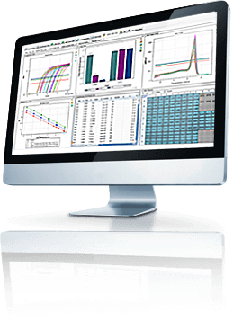
PCR-Based Tests
Viruses contain nucleic acid molecules (either DNA or RNA)
Infected individuals will have these nucleic acid molecules in their bodies.

Slide 7
Types of Polymerase Chain Reaction (PCR)
PCR (end point) — amplification of DNA template; analysis occurs after PCR, for example by gel electrophoresis
Reverse transcription PCR (RT-PCR) — RNA is transcribed into DNA which is amplified by PCR
Real-time PCR — PCR amplification is monitored in real time; can be quantitative (qPCR) or combined with RT-PCR (Real-Time RT-PCR)
Droplet digital PCR (ddPCR) — PCR in which single a sample is fractionated into thousands of droplets prior to amplification with theoretically only one template per droplet; amplification either occurs or it doesn’t (1 or 0, “digital”), which enables absolute quantitation
Isothermal recombinase polymerase amplification (RPA) — a modification of PCR using different enzymes that allows amplification from either RNA or DNA at a single temperature (relevant to CRISPR-based diagnostics)

Slide 8
Detection of SARS-CoV-2 RNA
Coronavirus contains RNA
PCR-based detection relies on Reverse transcription
Reverse transcription creates complementary DNA which can be amplified by PCR
www.scientificanimations.com/wiki-images/, CC BY-SA 4.0 commons.wikimedia.org/w/index.php?curid=86436446
Notes:
The polymerases used in PCR only amplify DNA. Reverse transcription is necessary first to create complementary DNA (cDNA).

Slide 9
Reverse Transcription PCR (RT-PCR)
Many copies of cDNA
PCR amplification
RNA isolation from sample
cDNA
Reverse transcription
Viral RNA
Notes:
In nature Some viruses (retroviruses) use reverse transcription to replicate and integrate within host genomes.
Its discovery earned researchers the 1975 Nobel Prize.
In medicine
Reverse transcriptase is a target for antivirals (AZT is an inhibitor of the HIV reverse transcriptase).
RT-PCR can detect RNA viruses like SARS-CoV-2.
In the research lab
Useful in gene expression studies (make cDNA), requires:
Reverse transcriptase (enzyme)
dNTPs and RNA template
Buffer and right temperature

Slide 10
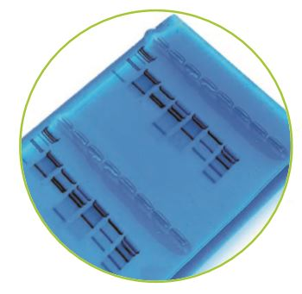
Amplification by End-Point or Real-Time PCR
End-point PCR
Real-time PCR
DNA must first be separated by gel electrophoresis
DNA staining and detection are done after PCR
Product is measured during the PCR
No electrophoresis required
Can be quantitative (qPCR) when compared to a standard curve
Notes:
Most SARS-CoV-2 tests are real-time rt-pcr.
Interactive PCR animation https://www.bio-rad.com/webroot/web/movies/lse/global/english/what-is-polymerase-chain-reaction/tutorial.html

Slide 11
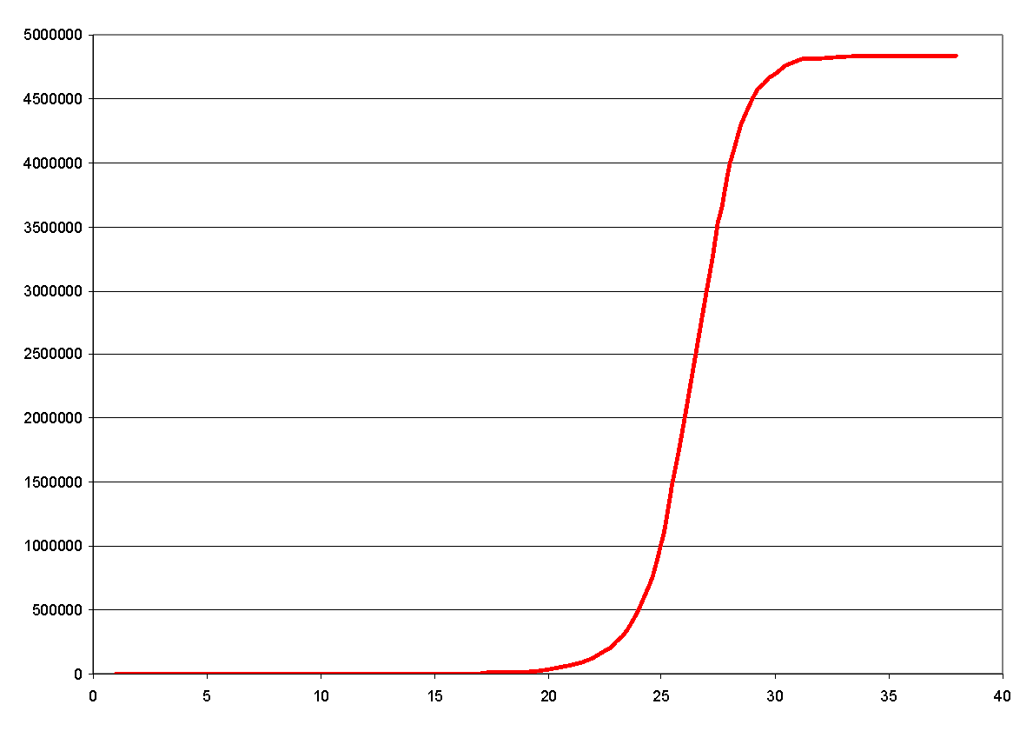
Real-Time PCR
Uses a fluorescent dye that binds to double stranded DNA or a fluorescent probe that is specific to the target sequence.
Once reagents run out, the #amplicons stays flat
Exponential growth in # of amplicons (doubles with each cycle of PCR)
Fluorescence (correlates to #amplicons)
Amplicons are tagged with a fluorescent dye or fluorophore for detection
# of PCR cycles
Notes:
Components of a real-time RT-PCT test
Sample — includes samples obtained from nasopharyngeal swabs or sputum, blood or serum
RNA extraction protocol and reagents
Primers — based on the genomic target; must be different from other closely related sequences to allow specificity
Reagents — depends on method and system used, but include reverse transcriptase, DNA polymerase dNTPs, buffers
Real-time PCR system — instrument for performing the reactions, detection
Positive and negative control samples
What would you use as a positive control? Negative control?
How would you get controls for a “novel” coronavirus?

Slide 12
Real-Time PCR
The number of cycles required to pass the detection threshold depends the amount of starting template
In that way, real-time PCR can be quantitative (“qPCR”)
Fluorescence detection:
Requires no gel electrophoresis
Higher throughput
More sensitive, faster than PCR
Fluorescence (correlates to #amplicons)
Detection threshold
# of PCR cycles

Slide 13
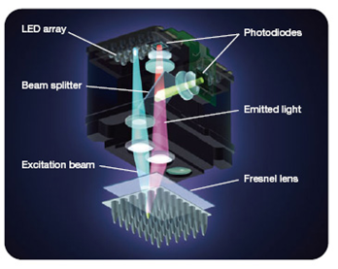
Real-Time PCR Instrumentation
Real-time instruments
Combine amplification and detection capabilities
Can process large numbers of samples simultaneously; automation increases throughput
Require installation, training; therefore they are usually available only in centralized testing facilities

Slide 14
Pros/Cons of Real-Time RT-PCR Tests
Pros
Cons
Detect active infections
Quick and easy (relatively) to define targets and design primers
Can work from simple tissue swabs (nasal or cheek) or sputum (blood not required)
High throughput
Some point-of-care (POC) options available
Cannot detect past infection
Best suited to centralized labs (instrumentation)
Tests can take 4–6 hr to complete
Accuracy can depend on viral load (LOD) (false negatives) — ~80–85%
Specificity — cross-reactivity with other viruses can be an issue
POC options still require specific instrumentation and offer lower throughput
Notes:
Visit https://www.fda.gov/medical-devices/emergency-situations-medical-devices/emergency-use-authorizations#covid19ivd to see a full list of approved SARS-CoV-2 diagnostic tests.
Want to know more about real-time PCR?
PowerPoint https://www.bio-rad.com/webroot/web/software/lse/Downloads/Real-Time_PCR_Basics.ppt
Webinar https://www.youtube.com/watch?v=HU6GUGvDLeg
Want to know more about the challenges of creating diagnostic tests?
Check out this article: https://www.modernhealthcare.com/technology/labs-face-challenges-creating-diagnosis-testing-covid-19

Slide 15
Droplet Digital PCR (ddPCR)
ddPCR…
is more sensitive that other PCR methods
fractionates a sample into 20,000 droplets
amplifies DNA target in every droplet
Counting the positive droplets gives precise, absolute target quantification
Notes:
For more information about ddPCR visit:
https://www.bio-rad.com/en-us/applications-technologies/introduction-digital-pcr?ID=MDV300E8Z

Slide 16
ddPCR for Viral Detection
Reverse-transcription ddPCR combines reverse transcription with ddPCR
accurate even in samples containing high background DNA or RNA or inhibitors — accuracy of ~98%
can discriminate between nucleotide variants common to RNA viruses
Allows absolute quantification — no need for a standard curve (faster, easier, more accurate, uses fewer wells so higher throughput)
RT-ddPCR useful for viral diagnostics, therapy development, and vaccine production
Notes:
For an example of a SARS-CoV-2 detection tool that uses ddPCR visit https://www.medrxiv.org/content/10.1101/2020.02.29.20029439v1

Slide 17
ELISA-Based Tests
Virus proteins are antigens
The immune system produces antibodies against the viral antigens
ELISA uses the specificity of antibodies to detect antigens or antibodies

Slide 18
SARS-CoV-2 Infection Timeline
As the virus multiplies, the concentration of viral antigens increase
The immune system produces antibodies IgA, IgM, and IgG in response to infection
As the immune response increases, the viral antigen concentration decreases
This graph is for illustrative purposes only - each type of infection has its own specific timeline.

Slide 19
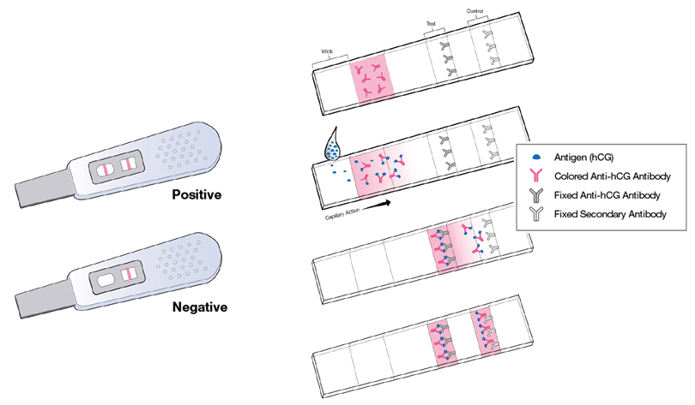
Enzyme-Linked Immunosorbent Assay (ELISA)
ELISA is a very common diagnostic technique
Rapid, easy, does not require instrumentation
Can detect active AND past infections
ELISA requires specific antigens or antibodies.
Lateral Flow versions (LFIA) use ELISA principles on a nitrocellulose strip.
Examples include:
Pregnancy, ovulation tests
Rapid Strep test
Flu test
A pregnancy test is based on the same principles as ELISA.

Slide 20
Detection of SARS-CoV-2 Proteins
Nucleocapsid (N)
Membrane (M)
Envelope (E)
Spike (S)
The spike protein is very “immunogenic” — the human body produces antibodies against the spike protein.
www.scientificanimations.com/wiki-images/, CC BY-SA 4.0 commons.wikimedia.org/w/index.php?curid=86436446

Slide 21
Detection of SARS-CoV-2 by ELISA
Antigen detection
Antibody detection
Screen patient for presence of the virus
Example —Yang AS et al. (2020) used monoclonal antibodies to screen patients for N-protein
Screen patient for anti-virus antibodies. Sometimes called a serology test
Example — Amanat et al. (2020) used recombinant S protein to screen patient samples for anti-S antibodies

Slide 22
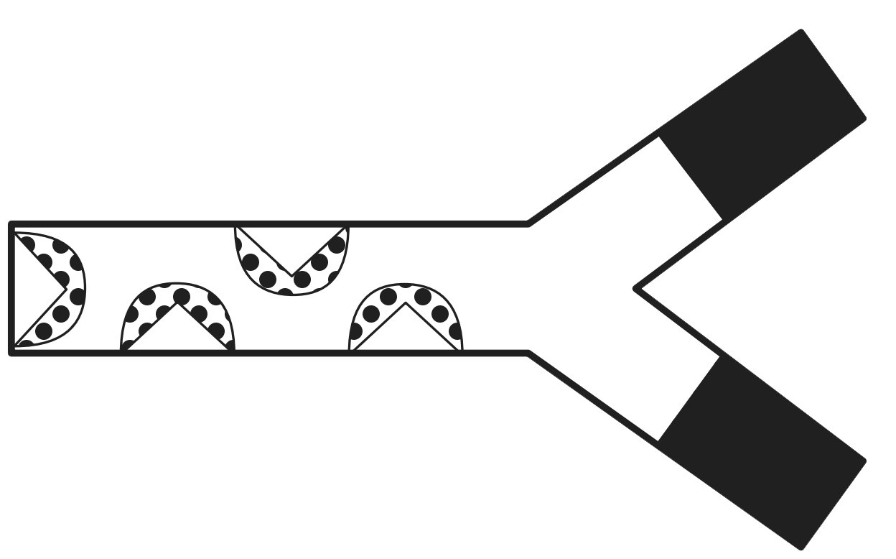
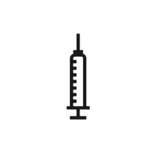
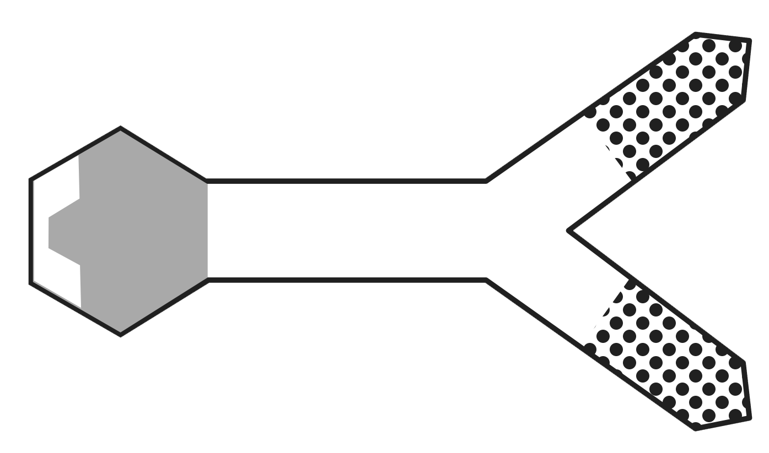
Antigen Detection ELISA Components
Antigen — in an antigen detection ELISA, the patient sample is tested for the presence of antigens from viruses, bacteria, etc.
Primary antibody — binds to the antigen
can be produced in a lab by injecting the target antigen into an animal and then harvesting the serum
Secondary antibody — binds to the constant region of the primary antibody
made by injecting the primary antibodies from one animal into a different animal
secondary antibodies are attached to an enzyme which catalyzes a color change when substrate is added
Substrate — changes color in the presence of the enzyme, indicating a positive result
Antigen
(virus)
Primary
Antibody
(rabbit anti-virus)
Secondary Antibody
(goat anti-rabbit)
Enzyme
Substrate
Notes:
ELISAs can provide current diagnostic information as well as historic information about viral exposure and immunity. These assays are based on antibody–antigen interactions, either with monoclonal antibodies (mAbs) to detect viral antigens in clinical samples or by using cloned viral antigens to detect antibodies against the virus in the patient
Want

Slide 23
Coronavirus Antibody Detection ELISA
Coronavirus Antibody Detection ELISA
Antigen
(lab-purified coronavirus S protein)
Coronavirus Infection
Coronavirus infects person
Patient Sample
(anti-coronavirus antibodies
will be present in sample if patient was infected)
Person makes antibodies against coronavirus
Secondary Antibody,
goat anti-human
(binds if anti-coronavirus human antibodies are present in the sample)
Enzyme
Substrate

Slide 24
Lateral Flow Serological Test for COVID-19
Lateral flow Immunoassay (LFIA) uses the same elements as ELISA
Samples are added to the wells
Capillary action carries the sample through regions containing the antibodies and probes in the nitrocellulose strip
Control
IgG
IgM
S
S
S
S
Sample

Slide 25
Pros/Cons of ELISA Tests
Pros
Cons
Can detect both active and past infections
Inexpensive
Does not require instrumentation; can be performed at point of care (LFIA format)
Can work from multiple sample types, depending on the assay
Rapid detection — within minutes
Less likely to produce false negatives
Longer development time — antibodies or antigens required for the test take time to identify and produce
Can be less specific — finding antibodies that can distinction between closely related viruses can be challenging
May not be sensitive enough during initial infection
Notes:
Visit https://www.fda.gov/medical-devices/emergency-situations-medical-devices/emergency-use-authorizations#covid19ivd to see a full list of approved SARS-CoV-2 diagnostic tests.

Slide 26
Value of Detecting Previous Infections
Better disease tracking
More accurate mortality and hospitalization rates
Can identify individuals who may be at lower risk of infection (useful for health care and other essential workers)*
Can identify blood plasma donors
Useful for studying and tracking vaccine efficacy
* The presence of antibodies indicates possible immunity but is not proof of immunity.

Slide 27
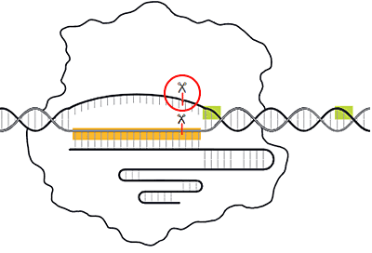
CRISPR-Based Tests
CRISPR gene editing using Cas9 has gained prominence
New Cas proteins expand the use of CRISPR into diagnostics
Cas9
Notes:
Mammoth Biosciences and Sherlock Biosciences, companies cofounded by CRISPR pioneers Jennifer Doudna and Feng Zhang, respectively, both aim to match its accuracy while achieving genuine POC testing speeds by employing the specificity and sensitivity of CRISPR–Cas editing to develop rapid POC SARS-CoV-2 tests.

Slide 28
CRISPR as a Diagnostic Tool
CRISPR diagnostics have two components:
Protein-guide complexes — cut a target sequence, then cut other nucleic acids indiscriminately
Reporters — labeled nucleic acid molecules that produce a visible signal when cut
Reporters are only cut if the target sequence is cut first.
Therefore, this system can be used to detect specific sequences.
Off
Cas
gRNA
Target sequence
On
Reporters
Signal

Slide 29
CRISPR SARS-CoV-2 Diagnostics in Development
DETECTR (Mammoth Biosci)
SHERLOCK (Sherlock Biosci)
Lateral flow assay requires 30–45 min
Uses Cas12a (lbCas12a)
Guide RNA (gRNA) targets sequences in the envelope (E) and nucelocapsid (N) genes of SARS-CoV-2
Initial validation shows 95% accuracy for positive detection and 100% for negative prediction
CRISPR assay on Cepheid GeneXpert platform
Lateral flow platforms also possible
Uses Cas13
Both involve reverse transcription of the viral RNA using isothermal recombinase polymerase amplification (RPA) in place of RT-PCR.

Slide 30
Pros/Cons of CRISPR tests
Pros
Cons
Highly sensitive and specific
Detects active infections
Rapid detection — within minutes to hours
Adaptable format — POC readers or centralized instrumentation
Accommodates multiple sample types
Can be reconfigured within days for new targets
Does not detect previous/past infections
More computationally demanding to develop than real-time PCR
Novel diagnostic test — not yet validated
Notes:
Visit https://www.fda.gov/medical-devices/emergency-situations-medical-devices/emergency-use-authorizations#covid19ivd to see a full list of approved SARS-CoV-2 diagnostic tests.

Slide 31
Summary of Diagnostic Test
 | Real-Time RT-PCR | ddRT-PCR | ELISA | CRISPR
Pros | Easy and fast to develop Accuracy | Absolute quantitation More sensitive than real-time RT-PCR Accuracy | Specific, can detect previous infection Results within 20 minutes Can be POC | Specific, accurate, rapid results POC possible Inexpensive
Cons | Complex, requires instrumentation Results usually in hours to days | Requires specific instrumentation Results usually in hours to days | Results may not be definitive due to the complexity of the immune response | Not yet validated

