Slide 1
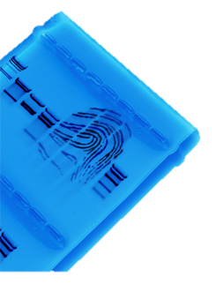
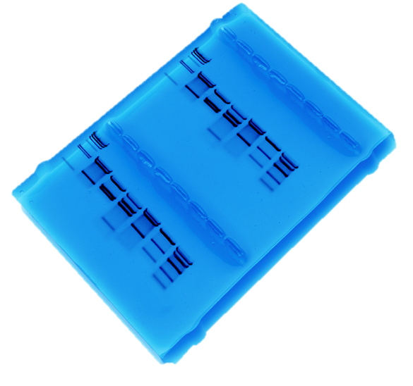
DNA Detectives
Bio-Rad Biotechnology Explorer™ DNA Fingerprinting Kit

Slide 2
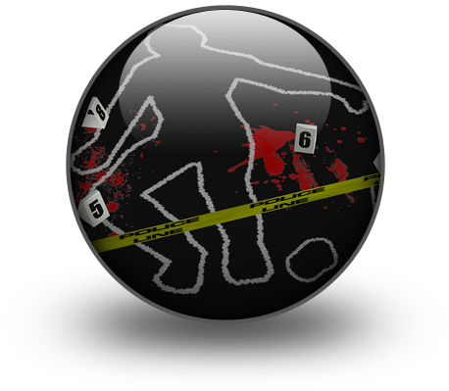
Crime Scene
Have fun setting up your own crime scene. Be as elaborate or as simple as you wish.

Slide 3
Dye Electrophoresis
Could you eliminate any suspects using dye electrophoresis?
What other methods might be more conclusive?

Slide 4
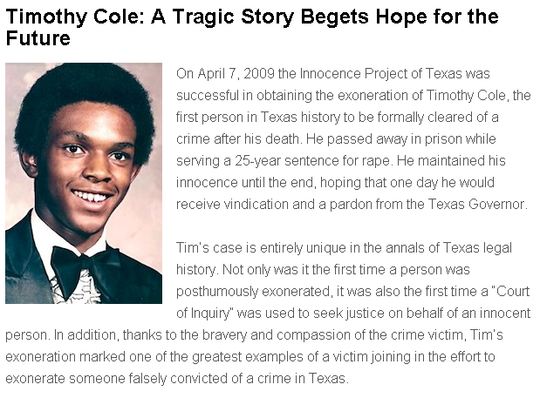
Innocence Project
302 DNA exonerations in the U.S. since 1989 (48 in TX)
Exonerees served an average of 13.6 years in prison
Flawed eyewitness testimony to blame for many cases

Slide 5
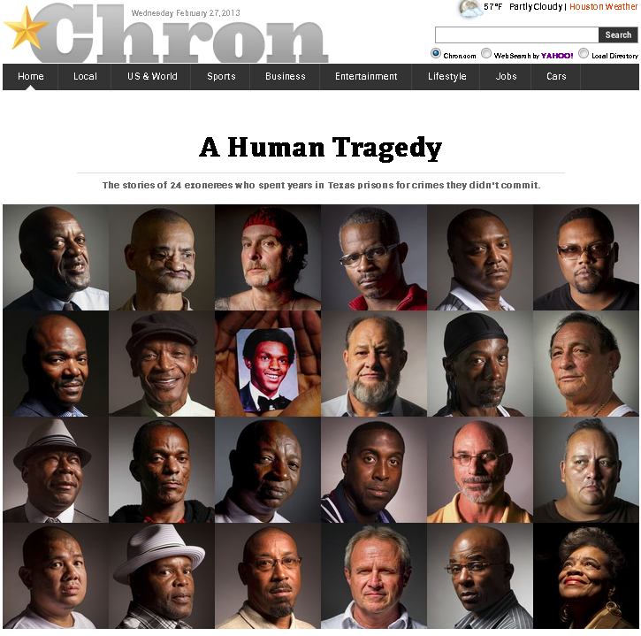
Innocence Project - Resources
Innocence Project:
www.innocenceproject.org
Innocence Project of Texas: www.ipoftexas.org
Houston Chronicle profiles:
www.chron.com/exonerees

Slide 6
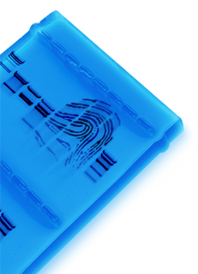
DNA Fingerprinting – Real World Applications
Crime scene
Human relatedness
Paternity
Animal relatedness
Anthropology studies
Disease-causing organisms
Food identification
Human remains
Monitoring transplants

Slide 7
DNA Fingerprinting Lab – Day 1

Slide 8
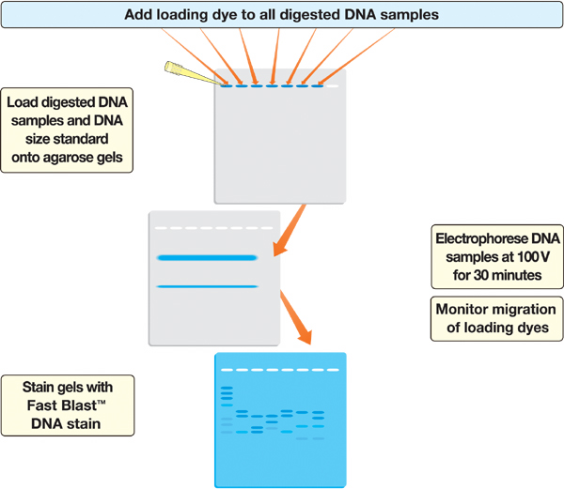
DNA Fingerprinting Lab – Day 2

Slide 9
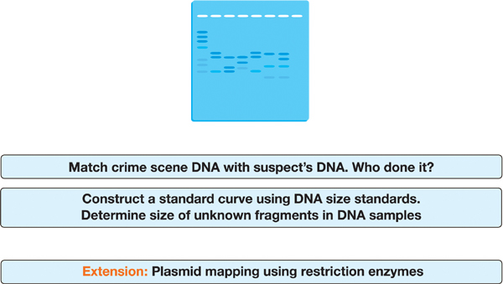
DNA Fingerprinting Lab – Day 3

Slide 10
How to use a micropipet
Play video demonstration or demonstrate live
http://www.bio-rad.com/webroot/web/html/lse/support/tutorial_micropipet_wndw.html

Slide 11
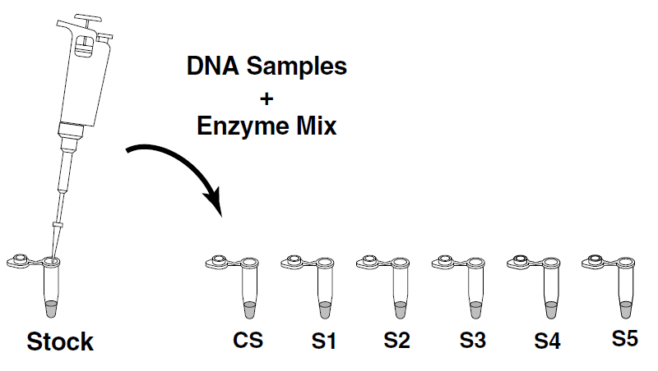
Let’s Get Started!
Place your crime scene (CS) and suspect DNA (S1-5) in your foam rack. Write your initials on your tubes.
Pipet 10 ul of enzyme (ENZ) into each of your tubes. Use a separate tip for each sample!
10 ul
ENZ

Slide 12
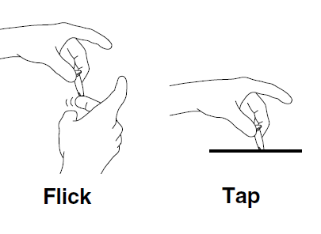
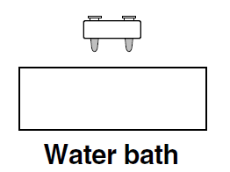
Let’s Get Started!
Cap the tubes, flick the bottom of each one to mix, and then bring contents to bottom by tapping on the table.
Place your tubes (in the foam rack) in a 37 degree water bath.

Slide 13
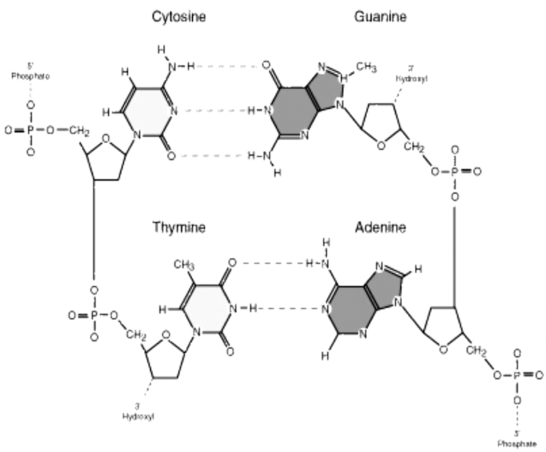
DNA Structure

Slide 14
DNA Schematic

Slide 15
Student DNA Model

Slide 16
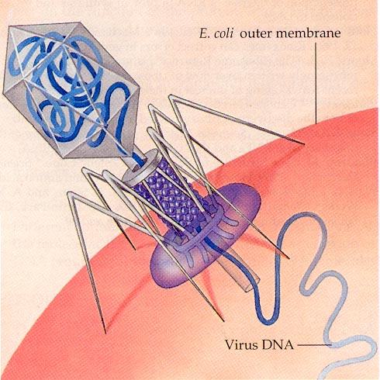
Restriction Enzymes
Evolved by bacteria to protect against viral DNA infection
Endonucleases = cleave within DNA strands
Over 3,000 known enzymes

Slide 17
DNA Digestion Reaction
Restriction Buffer provides optimal conditions
NaCI provides the correct ionic strength
Tris-HCI provides the proper pH
Mg²⁺ is an enzyme co-factor

Slide 18
Enzyme Site Recognition
Restriction site
Each enzyme digests (cuts) DNA at a specific sequence = restriction site
Enzymes recognize 4- or 6- base pair, palindromic sequences
(eg GAATTC)
Palindrome
Fragment 1
Fragment 2

Slide 19
5 Prime Overhang
Enzyme cuts

Slide 20
Common Restriction Enzymes
EcoRI
– Eschericha coli
– 5 prime overhang
Pstl
– Providencia stuartii
– 3 prime overhang

Slide 21
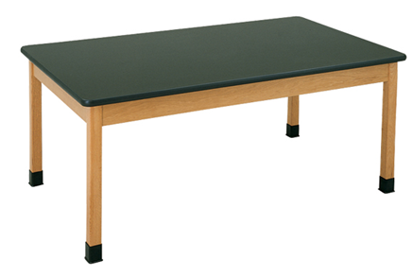
Classroom Obstacle Course

Slide 22
Restriction Fragment Length Polymorphism RFLP
PstI
EcoRI
CTGCAG
GAGCTC
GAATTC
GTTAAC
Allele 1
1
2
3
CGGCAG
GCGCTC
GAATTC
GTTAAC
Allele 2
Fragment 1+2
3
Different
Base Pairs
No restriction site
M
A-1
A-2
Electrophoresis of restriction fragments
M: Marker
A-1: Allele 1 Fragments
A-2: Allele 2 Fragments
+

Slide 23
How to load an agarose gel
Play video demonstration or demonstrate live
http://www.bio-rad.com/webroot/web/html/lse/support/tutorial-agarose-gel-electrophoresis-wndw.html

Slide 24
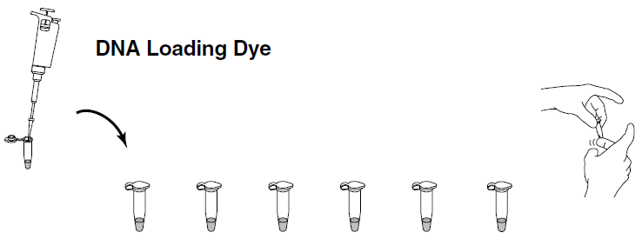
Gel Electrophoresis
Collect your DNA samples from the water bath.
Add 4 ul of Uview loading dye (LD) into each of your tubes. Use a separate tip for each sample! Cap the tubes and mix by flicking with your finger.

Slide 25
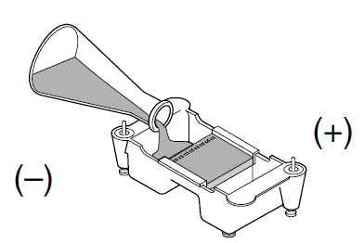
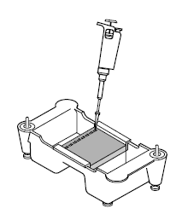
Gel Electrophoresis
Place an agarose gel in the gel box. Make sure the wells are near the black (-) electrode.
Using a separate tip for each sample, load your gel:
Lane 1: M, DNA size marker, 10 μl
Lane 2: CS, green, 20 μl
Lane 3: S1, blue, 20 μl
Lane 4: S2, orange, 20 μl
Lane 5: S3, violet, 20 μl
Lane 6: S4, red, 20 μl
Lane 7: S5, yellow, 20 μl

Slide 26
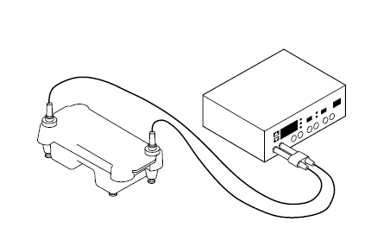
Gel Electrophoresis
Place the lid on the gel box, and plug the electrodes into the power supply. Electrophoresis at 200V for 20 minutes.

Slide 27
Student Inquiry – Question to Consider
How important is each step in the lab protocol?
What part of the protocol can I manipulate to see a change in the results?
Possible variables:
enzyme concentration
substrate concentration
incubation temp or time
enzyme or DNA UV exposure
methylated plasmid
agarose concentration
buffer concentration
running time.
How do I insure the changes I make is what actually affects the outcome (importance of controls).
Write the protocol. After approval – do it!

Slide 28
Student Inquiry – Advanced Question
What can I learn about these plasmids?
Can I use these plasmids to successfully transform bacteria?
Can I ligate these plasmids together and successfully transform bacteria?
Can I do a restriction digest on pGLO plasmid?
Can I determine the plasmid map using different enzymes?

Slide 29
Student Inquiry – Teacher Considerations
What materials and equipment do I have on hand, and what will I need to order?
Extra agarose, DNA, different / more restriction enzymes?
Water bath (different temps)
Other supplies depending on student questions (mini prep, thermal cyclers, etc)
Consider buying extras in bulk or as refills – many have 1 year + shelf life.
What additional prep work will I need?
Order supplies
Pour gels
How much time do I want to allow?
Limited time? Have students read lab and come up with inquiry questions and protocol before they start. Collaborative approach.
Will you need multiple lab periods?
Will everyone need the same amount of time?

Slide 30
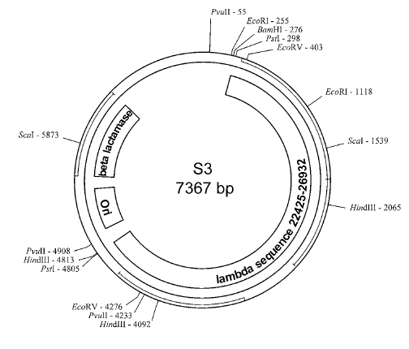
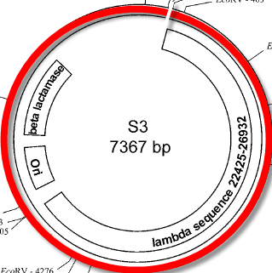
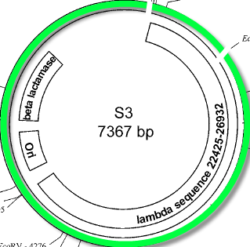
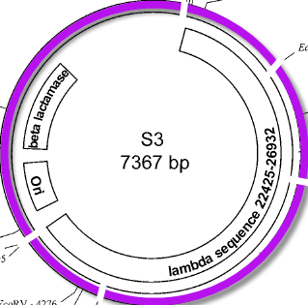
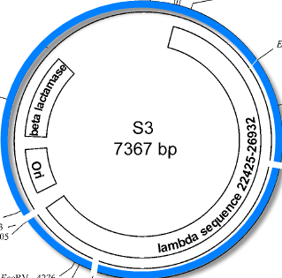
Plasmid Map and Restriction Sites
863bp
3469bp
863bp
2027bp
BamHI
Hind III
EcoRI
EcoRI+ HindIII
947bp
721bp
7367bp
721bp
1659bp
2027bp
6504bp
BamHI:
EcoRI:
HindIII:
EcoRI+Hind III:
1 linear fragment; 7367bp
2 fragments; 863bp / 6504bp
3 fragments; 721bp/2027bp/3469bp
5 fragments; 721bp/863bp/947bp/1659bp/2027bp

Slide 31
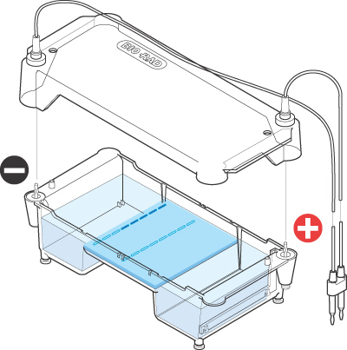
Electrical current carries negatively-charged DNA through gel towards positive (red) electrode
Buffer
Dyes
Agarose gel
Power Supply

Slide 32
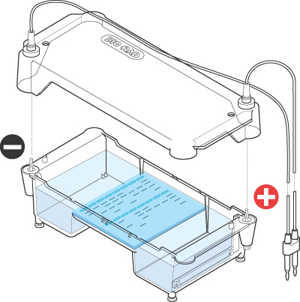
Agarose Electrophoresis
Agarose gel separates DNA fragments according to size
Electrical current carries (-) charged DNA through gel to (+) electrode.
Small fragments move faster than large fragments
Buffer
DNA &
Loading Dye
Agarose
gel
Power Supply

Slide 33
Analysis of Stained Gel
Determine restriction fragment sizes
Create standard curve using DNA marker
Measure distance traveled by restriction fragments
Determine size of DNA fragments
Identify the related samples

Slide 34
Molecular Weight Determination
Fingerprinting Standard Curve: Semi-log
Size (bp) Distance (mm)
23,000 11.0
9,400 13.0
6,500 15.0
4,400 18.0
2,300 23.0
2,000 24.0

Slide 35
DNA Digestion Temperature
Why incubate at 37°C?
Body temperature is optimal for these and most other enzymes
What happens if the temperature is too hot or cool?
Too hot = enzyme may be denatured (killed)
Too cool = enzyme activity lowered, requiring longer digestion time

