Slide 1
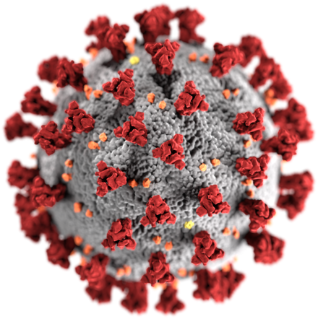
The Biology of SARS-CoV-2

Slide 2
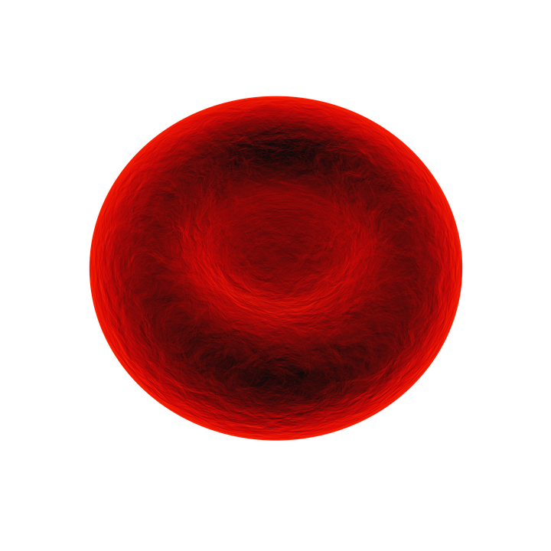
What is a virus?
Watch Viruses with the Amoeba Sisters (6:49 min) to learn more about viruses
Viruses…
are much smaller than cells
have nucleic acid (either DNA or RNA) wrapped in a protein coat
may have a lipid envelope (from the host cell membrane)
Have no metabolism
Cannot replicate (reproduce) on their own
Can multiply only within the living cells of a host
Virus
~100 nm
Red blood cell
~7,000 nm

Slide 3
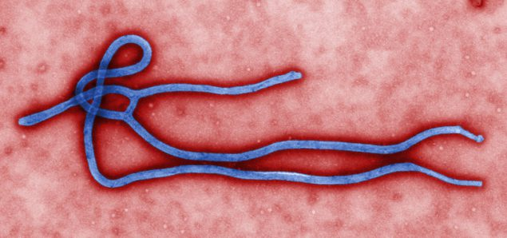
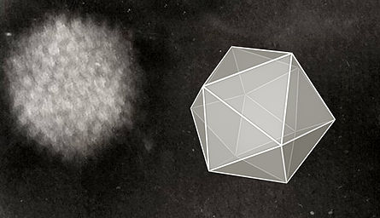
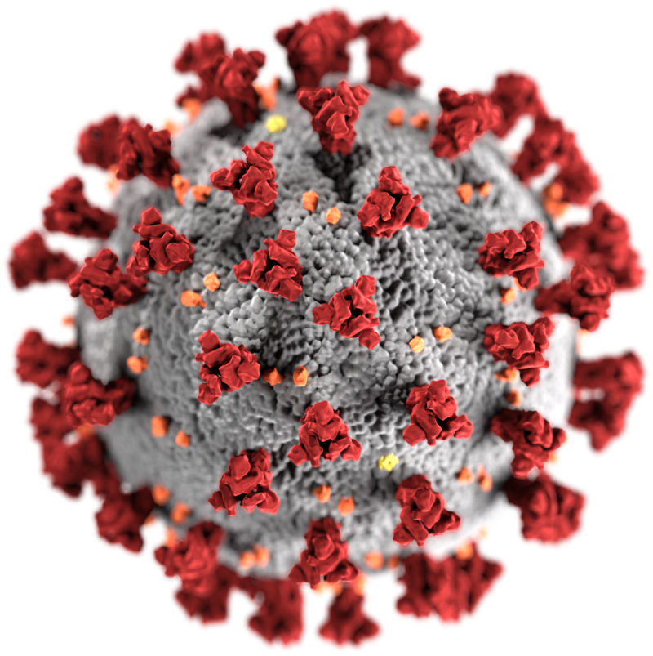
Types of viruses
Viruses are classified by
Morphology (shape)
Genome material (RNA or DNA)
Type of replication
Host
Type of disease
Ebola virus
Bacteriophage
Ninjatacoshell - Own work, CC BY-SA 4.0, https://commons.wikimedia.org/w/index.php?curid=35782607
Centers for Disease Control and Prevention's Public Health Image Library (PHIL)
Adenovirus
Coronavirus
CDC/ Alissa Eckert, MS; Dan Higgins, MAM - commons.wikimedia.org/w/index.php?curid=86444014
GrahamColm at English Wikipedia, CC BY-SA 3.0,commons.wikimedia.org/w/index.php?curid=5839864

Slide 4
Are viruses living?
Curriculum connections
Cell theory
The chemistry of life
Living Organisms
Viruses
Composed of one or more cells
Organelles for specialized functions (eukaryotes)
Energy flow (metabolism) occurs within the cells
Arise from pre-existing cells (can self-replicate)
Composed of genetic material (DNA or RNA) surrounded by protein and sometimes a lipid bilayer
No organelles
Do not metabolize (no energy flow)
Cannot reproduce on their own (need a host cell for replication)

Slide 5
Coronavirus — What’s in a name?
Coronavirus (CoV) — a large family of viruses that can cause disease in humans and animals
SARS-CoV-2 (Severe Acute Respiratory Syndrome Coronavirus-2) — the strain of virus causing the current pandemic
COVID-19 (Coronavirus Disease 2019) — the set of symptoms caused by SARS-CoV-2
corona – latin for crown
Transmission electron micrograph of SARS-CoV-2 virus particles, isolated from a patient.
Credit: National Institute of Allergy and Infectious Diseases, NIH

Slide 6
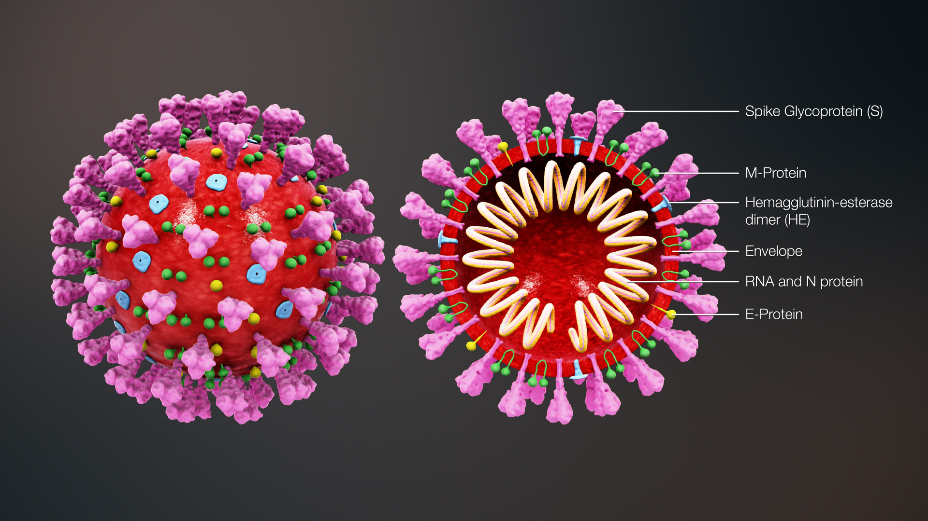
SARS-CoV-2 Structure
www.scientificanimations.com/wiki-images/, CC BY-SA 4.0 commons.wikimedia.org/w/index.php?curid=86436446
Notes:
Helical nucleocapsid: 30 kb (huge!) + sense RNA coated with N protein
M protein contacts N protein at points.
Other proteins are present in other types of CoV (ex: HE)
NYT Interactive Bad News Wrapped In Protein: https://www.nytimes.com/interactive/2020/04/03/science/coronavirus-genome-bad-news-wrapped-in-protein.html
See info on individual proteins here: https://zhanglab.ccmb.med.umich.edu/COVID-19/
Lipid envelope is why soap is so effective - it disrupts the envelope and the virus falls apart. RNA by itself can not enter cells.

Slide 7
SARS-CoV-2 Structure
Spike protein (S)
~150 kDa
Attaches to ACE-2 receptor
Membrane protein (M)
~25–30 kDa
Provides shape
Envelope protein (E)
~8–12 kDa
Guides assembly and release
Nucleocapsid protein (N)
~50 kDa
Protects RNA
RNA viral genome
~30,000 nucleotides (huge!)
Encodes 29 proteins
Lipid envelope
Acquired from host cell
www.scientificanimations.com/wiki-images/, CC BY-SA 4.0 commons.wikimedia.org/w/index.php?curid=86436446
Notes:
Helical nucleocapsid: 30 kb (huge!) + sense RNA coated with N protein
M protein contacts N protein at points.
Other proteins are present in other types of CoV (ex: HE)
NYT Interactive Bad News Wrapped In Protein: https://www.nytimes.com/interactive/2020/04/03/science/coronavirus-genome-bad-news-wrapped-in-protein.html
See info on individual proteins here: https://zhanglab.ccmb.med.umich.edu/COVID-19/
Lipid envelope is why soap is so effective - it disrupts the envelope and the virus falls apart. RNA by itself can not enter cells.

Slide 8
Why is washing with soap an effective way to remove SARS-CoV-2?

Slide 9
How does SARS-CoV-2 infect a cell?
Virus particles enter the body through the nasal passages.
The spike protein attaches to cell receptors — angiotensin-converting enzyme 2 (ACE2).
Viral membrane fuses with the cell membrane
The RNA genome is released into the cell.
The cell replicates the virus using its RNA genome

Slide 10
Images of Infected Cells (colorized)
Credit: NIAID-RML
Credit: National Institute of Allergy and Infectious Diseases, NIH
This scanning electron microscope image shows SARS-CoV-2 (round blue objects) emerging from the surface of cells cultured in the lab.
Colorized scanning electron micrograph of an apoptotic cell (greenish brown) heavily infected with SARS-COV-2 virus particles (pink), isolated from a patient sample.

