Slide 1
Detecting SARS-CoV-2 using ELISA
Simulated using Bio-Rad’s ELISA Immuno Explorer Kit
BIO-RAD is a trademark of Bio-Rad Laboratories, Inc. in certain jurisdictions. All trademarks used herein are the property of their respective owner.
© 2020 Bio-Rad Laboratories, Inc.

Slide 2
Contents
Getting
Started
Getting Started
Instructor Preparation
Student Slides
Introduction
Additional Resources
Required Materials
Adaptation Instructions
Scenario
Protocol steps

Slide 3
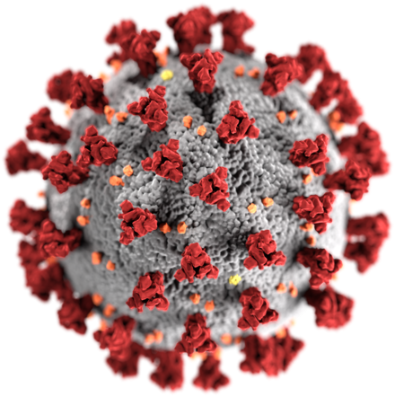
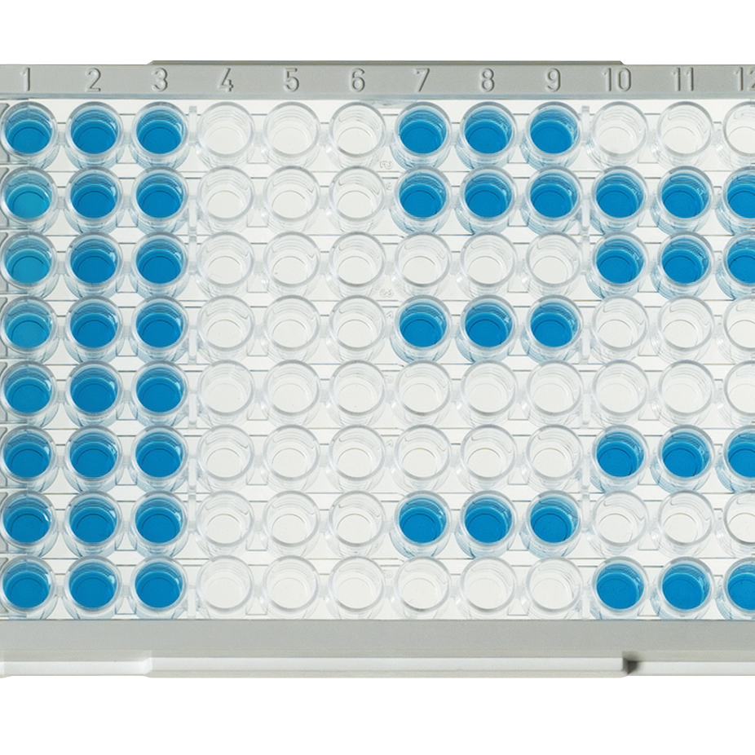
Introduction
Getting
Started
Bio-Rad’s ELISA Immuno Explorer Kit allows your students to explore how the properties of antibodies can be used to detect disease agents using real antibodies.
This slide deck provides information for how to use the kit to teach immunology and ELISA in the context of COVID-19. The scenario presented here is a simulation. No human samples are used.
The ELISA Immuno Explorer Kit can be configured to simulate either antigen or antibody detection. Both types of detection are relevant to the diagnosis of COVID-19 but serve different purposes. Here an antibody detection test is presented. Instructions for how to use the antigen detection test are provided in the ELISA Immuno Explorer Kit instruction manual

Slide 4
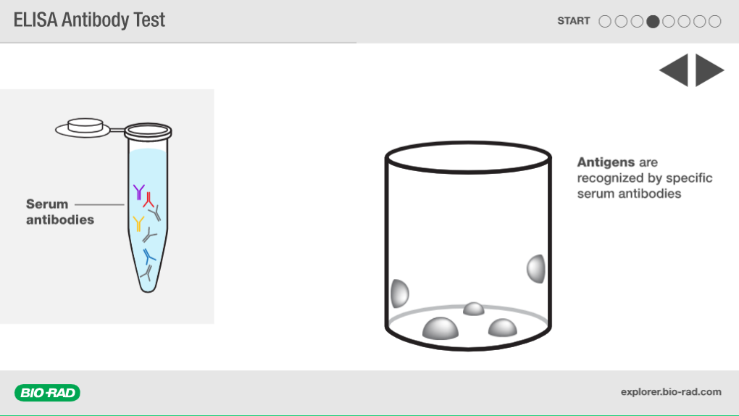
Additional Resources
Getting
Started
Visit bio-rad.com/teachingresources for more background information about SARS-CoV-2 detection. Below are two free interactive student resources about how ELISA works.
ELISA Antibody Test interactive animation
ELISA paper modeling activity

Slide 5
Required Materials
Instructor Preparation
ELISA Immuno Explorer Kit (1662400EDU)
Recommended Accessories Not Included in Kit:
20–200 µl Adjustable volume micropipet (2112016EDU) and tips ( ) | 12
Or
50 µl fixed volume micropipets (1660515EDU) and tips (2239035EDU) | 12

Slide 6
Adaptation Instructions
Instructor Preparation
A printed copy of the ELISA Immuno Explorer Kit instruction manual is included with purchase of the kit but can also be downloaded from the product web page.
Prepare the ELISA Immuno Explorer Kit using Protocol III: Antibody Test.
Use SARS-CoV-2 and COVID-19 as the disease for the scenario with the following naming:
Sample | Contents Description for the Scenario | Label
Positive control | Positive patient serum | +
Negative control | Negative patient serum | –
Purified antigen | Purified SARS-CoV-2 spike protein | AG
Secondary antibody | Enzyme-conjugated anti-human Ig antibody | SA
Substrate | Enzyme substrate | SUB
Patient samples | Serum from patients | Patient ID #

Slide 7
Scenario
You are working in a diagnostic lab that is using an ELISA antibody test to determine if patients have been exposed to SARS-CoV-2.
When patients are infected with SARS-CoV-2 their immune systems create antibodies in response to the virus. The ELISA antibody test will detect those antibodies in a serum (blood) sample.

Slide 8
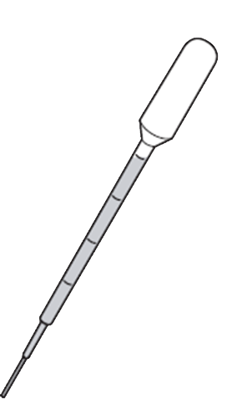
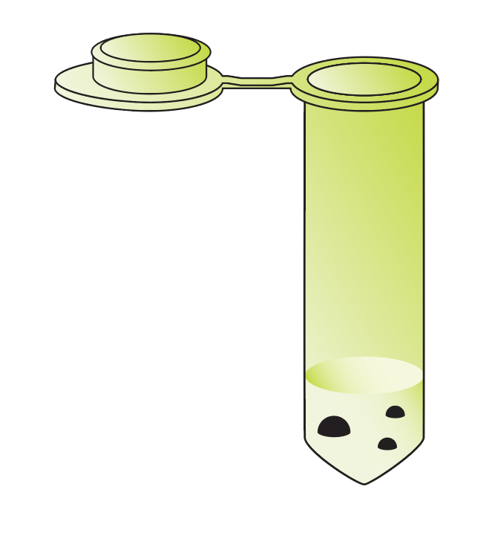
Add Purified Antigen
Add 1 drop of purified antigen (AG) to each well.
2–5 min
1 drop / well

Slide 9
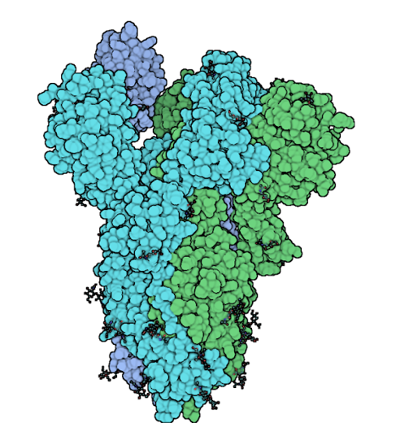
What are antigens?
Antigen — foreign substances that trigger an immune response
The CDC recommends using the SARS-CoV-2 spike protein as the antigen for an antibody ELISA when
Spike protein
SARS-CoV-2
Notes:
When an individual is exposed to SARS-CoV-2, the immune system produces antibodies that are specific to the virus. Any part of the virus, e.g. the spike or nucleocapsid proteins, can and does act as an antigen, and the immune system creates antibodies against each. Many viruses have components that are similar enough that the same antibody will bind to components from multiple viruses. When creating an ELISA for diagnostic purposes, it is important to detect antibodies that are only active against components of the virus in question. The CDC has recommended that a stabilized form of the SARS-CoV-2 spike protein be used as the antigen in an antibody test ELISA. This spike protein is unique to SARS-CoV-2 and the specificity of antibodies to antigens allows the ELISA to indicate the presence of the spike protein and therefore SARS-CoV-2.

Slide 10
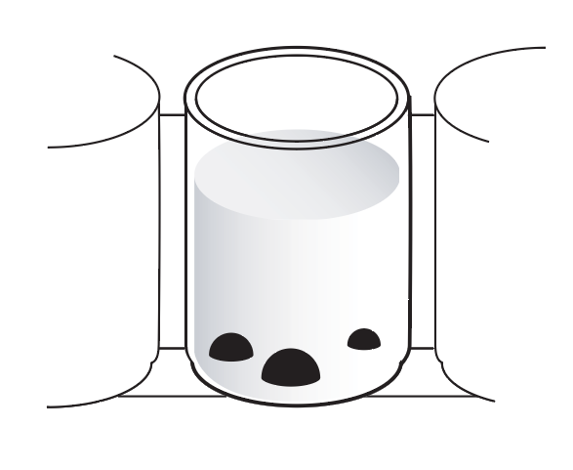
Antigen Binding
Antigens (and all proteins) will bind to the microplate wells nonspecifically
Why add the antigen to the wells first?
Protein (Antigen)
H
H
R
R
Polystyrene (plate)
Notes:
We add antigen to the wells first so that in the next step only antibodies that bind to the antigen are captured.

Slide 11
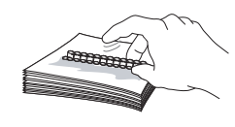
Wash Wells (x2)
Use a clean pipet. Almost fill each well with wash buffer. DO NOT OVERFLOW.
Tap wash buffer out onto a napkin. Repeat. Be careful not to cross contaminate wells.
WASH

Slide 12
Why is washing important?
Remove unbound antigen
Blocks the rest of the well surfaces so that nothing else binds nonspecifically

Slide 13
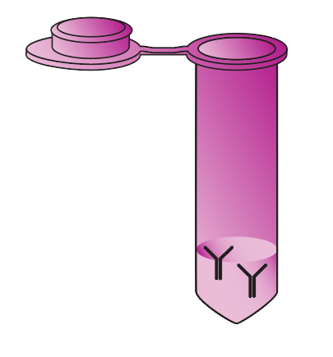
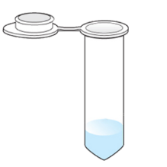
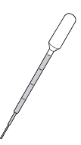
Add Controls and Patient Samples
Add one drop of the appropriate sample to each well. Follow the chart.
?
?
Tube | (+) | (–) | Patient ID | Patient ID
Amount | 1 drop | 1 drop | 1 drop | 1 drop
2–5 min

Slide 14
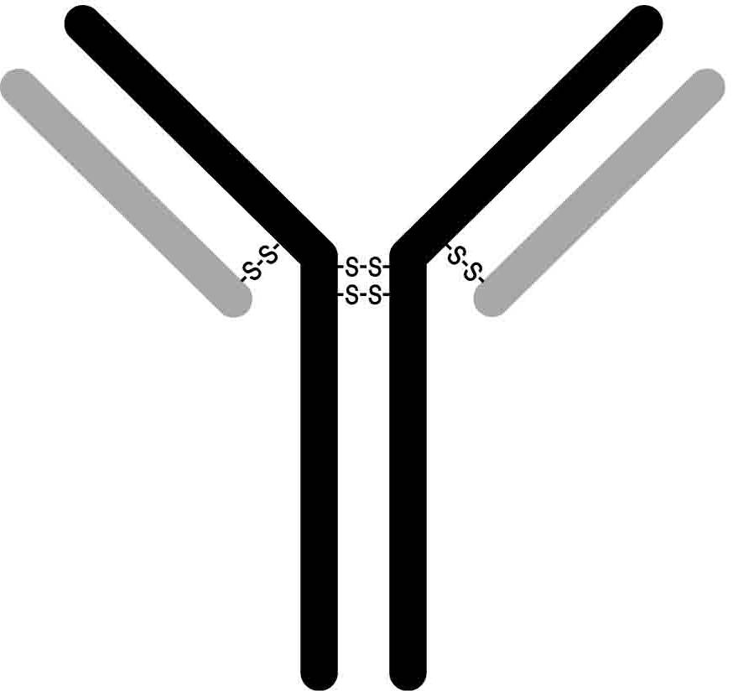
What is a serum antibody?
Antibodies in the bloodstream that bind directly and specifically to antigens like the spike protein
The specificity is key to how an ELISA works.
constant region
light chain
Antigen
variable region
heavy chain
3,368,600 antibody combos

Slide 15
Wash Wells (x2)
Use a clean pipet. Almost fill each well with wash buffer. DO NOT OVERFLOW.
Tap wash buffer out onto a napkin. Repeat. Be careful not to cross contaminate wells.
WASH

Slide 16
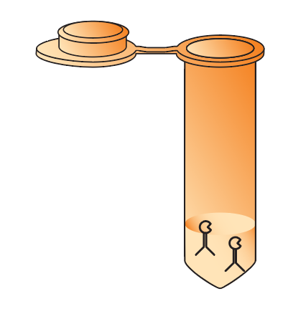
Add Secondary Antibody
Add 1 drop of secondary antibody (SA) to each well
2–5 min

Slide 17
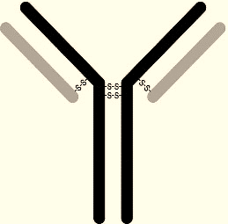
What is a secondary antibody?
Secondary antibodies bind specifically to serum antibodies.
They bind to the constant region of serum antibodies
Multiple secondary antibodies may bind to increase signal
Usually, an enzyme or fluorescent dye is attached so that they can be detected.
Secondary antibody
Enzyme
Serum antibody

Slide 18
Wash Wells (x3)
Use a clean pipet. Almost fill each well with wash buffer. DO NOT OVERFLOW.
Tap wash buffer out onto a napkin. Repeat. Be careful not to cross contaminate wells.
WASH

Slide 19
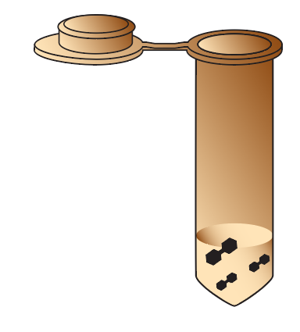
Add substrate
Add 1 drop of substrate (SUB) to each well.
2–5 min

Slide 20
Enzyme-Substrate Reaction
Color change reaction
Substrate turns blue if enzyme is present.
Enzyme
Substrate
Secondary antibody
Blue product

Slide 21
Possible Results

